Slide 1
The Transport Layer
Chapter 6

Slide 2
The Transport Service
Services Provided to the Upper Layers
Transport Service Primitives
Berkeley Sockets
An Example of Socket Programming:
An Internet File Server

Slide 3
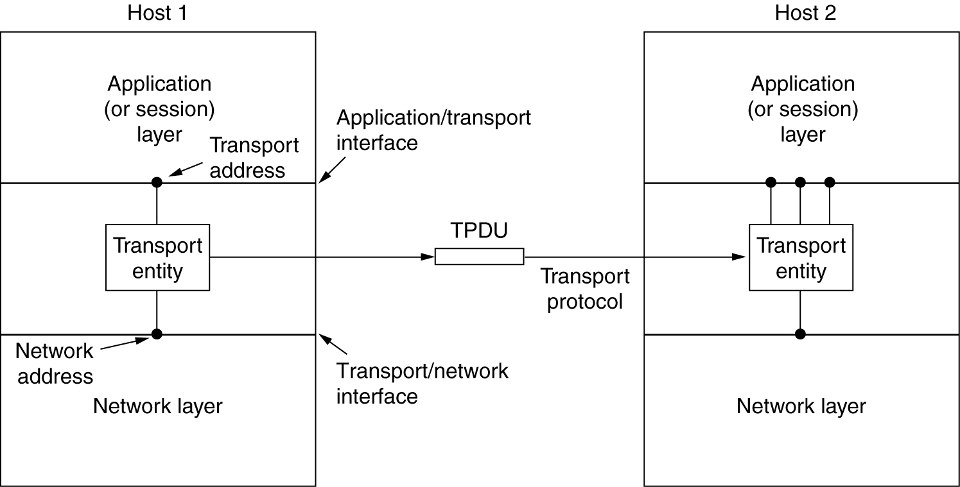
Services Provided to the Upper Layers
The network, transport, and application layers.

Slide 4
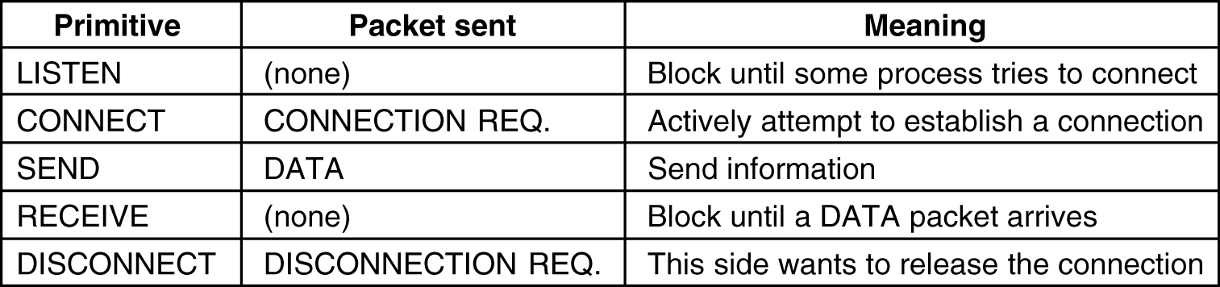
Transport Service Primitives
The primitives for a simple transport service.

Slide 5
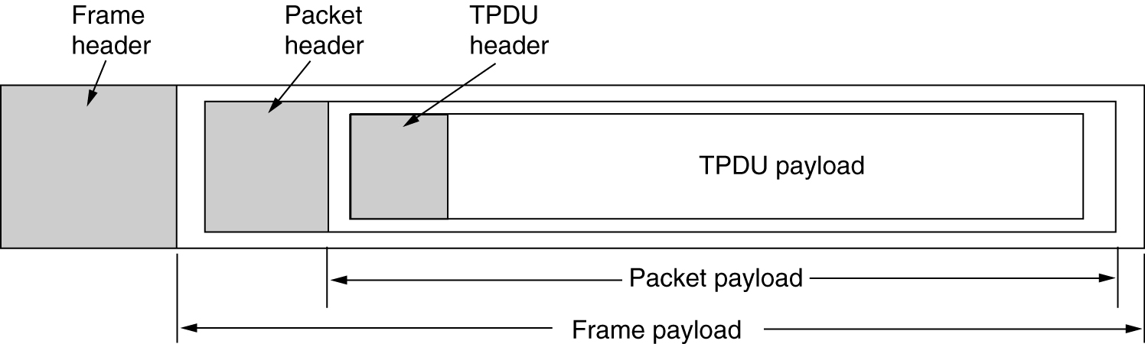
Transport Service Primitives (2)
The nesting of TPDUs, packets, and frames.

Slide 6
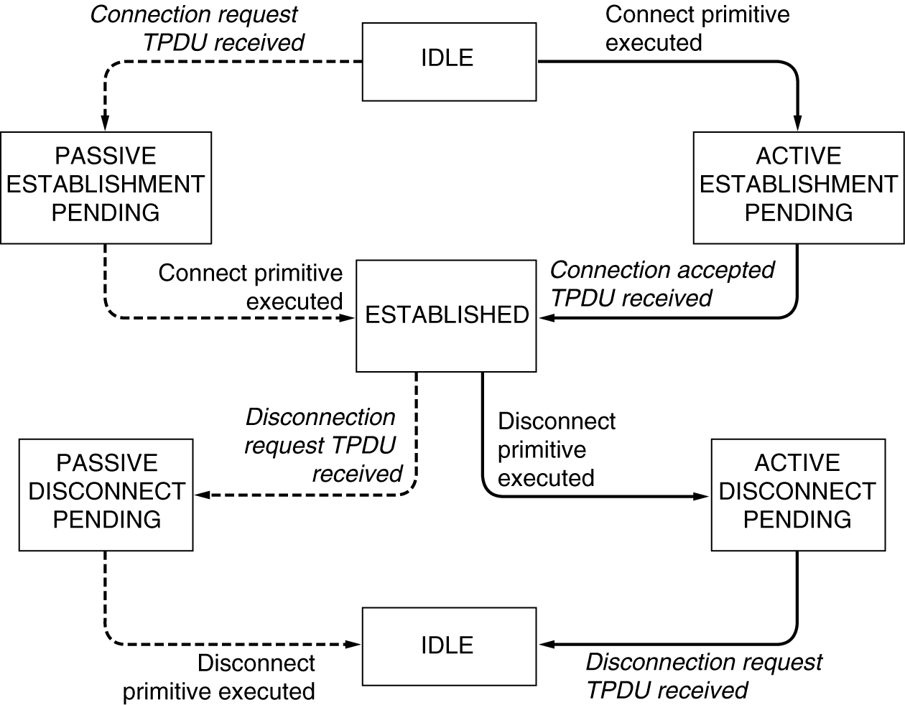
Transport Service Primitives (3)
A state diagram for a simple connection management scheme. Transitions labeled in italics are caused by packet arrivals. The solid lines show the client's state sequence. The dashed lines show the server's state sequence.

Slide 7
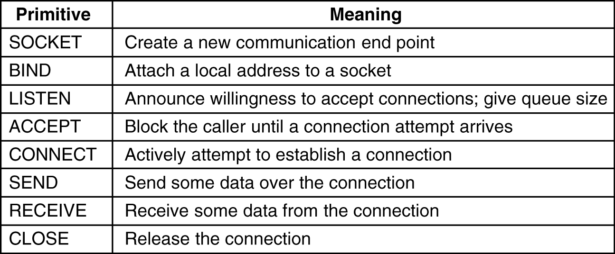
Berkeley Sockets
The socket primitives for TCP.

Slide 8
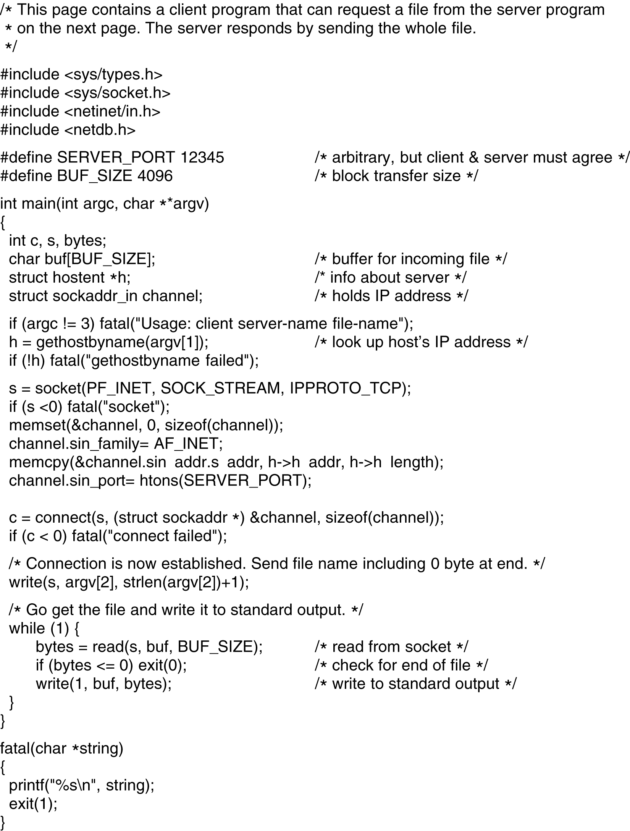
Socket Programming Example: Internet File Server
6-6-1
Client code using sockets.

Slide 9
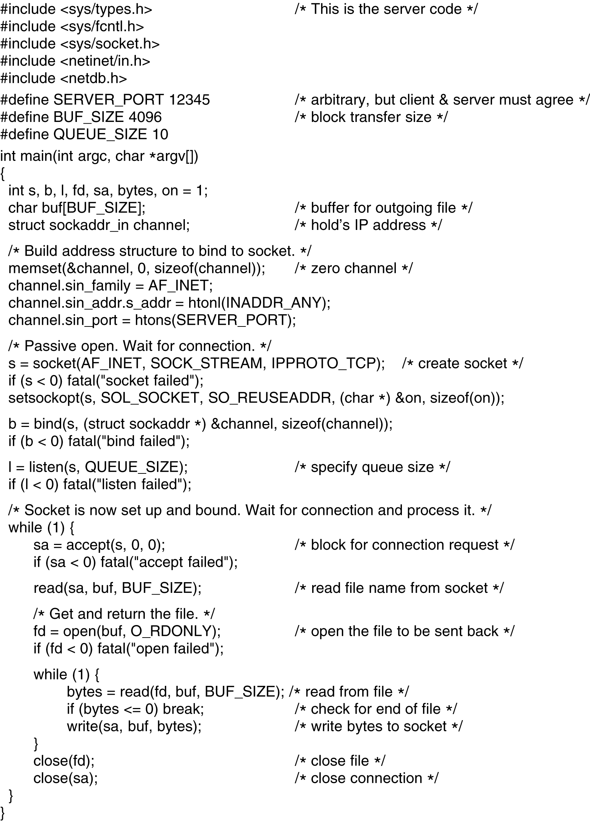
Socket Programming Example: Internet File Server (2)
Client code using sockets.

Slide 10
Elements of Transport Protocols
Addressing
Connection Establishment
Connection Release
Flow Control and Buffering
Multiplexing
Crash Recovery

Slide 11
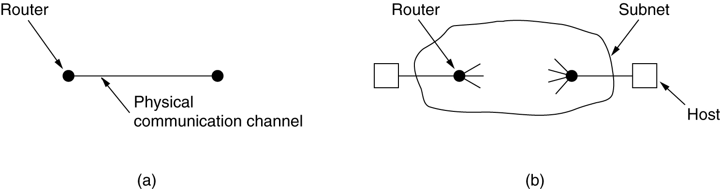
Transport Protocol
(a) Environment of the data link layer.
(b) Environment of the transport layer.

Slide 12
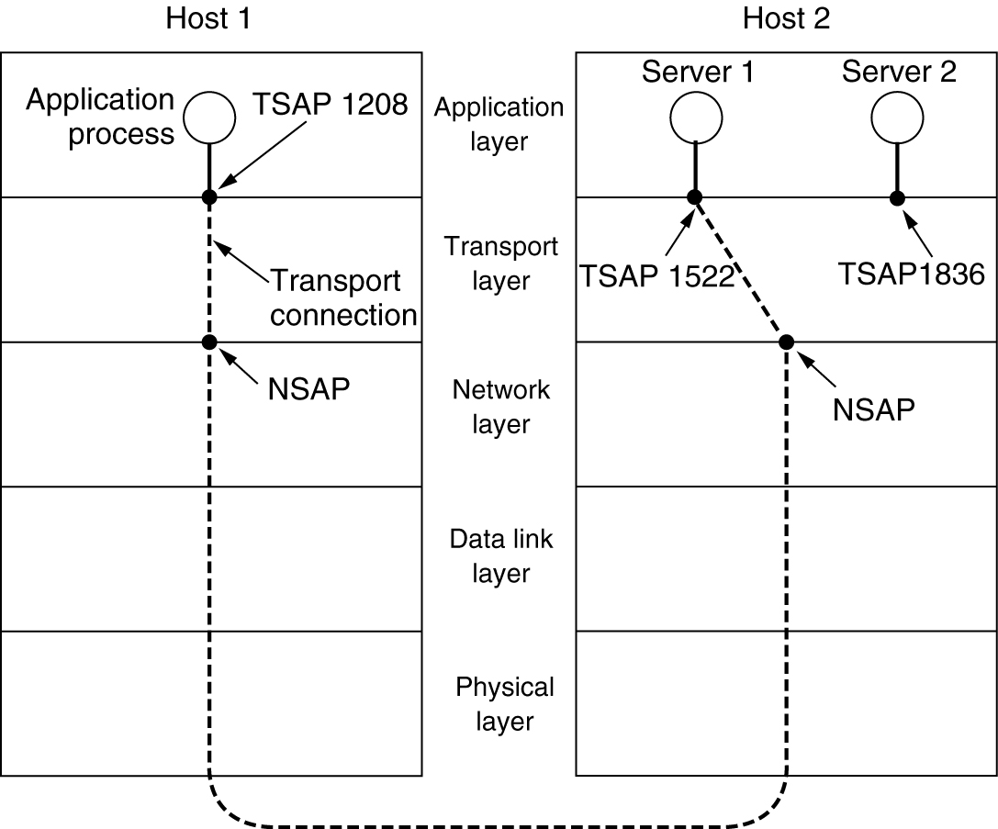
Addressing
TSAPs, NSAPs and transport connections.

Slide 13
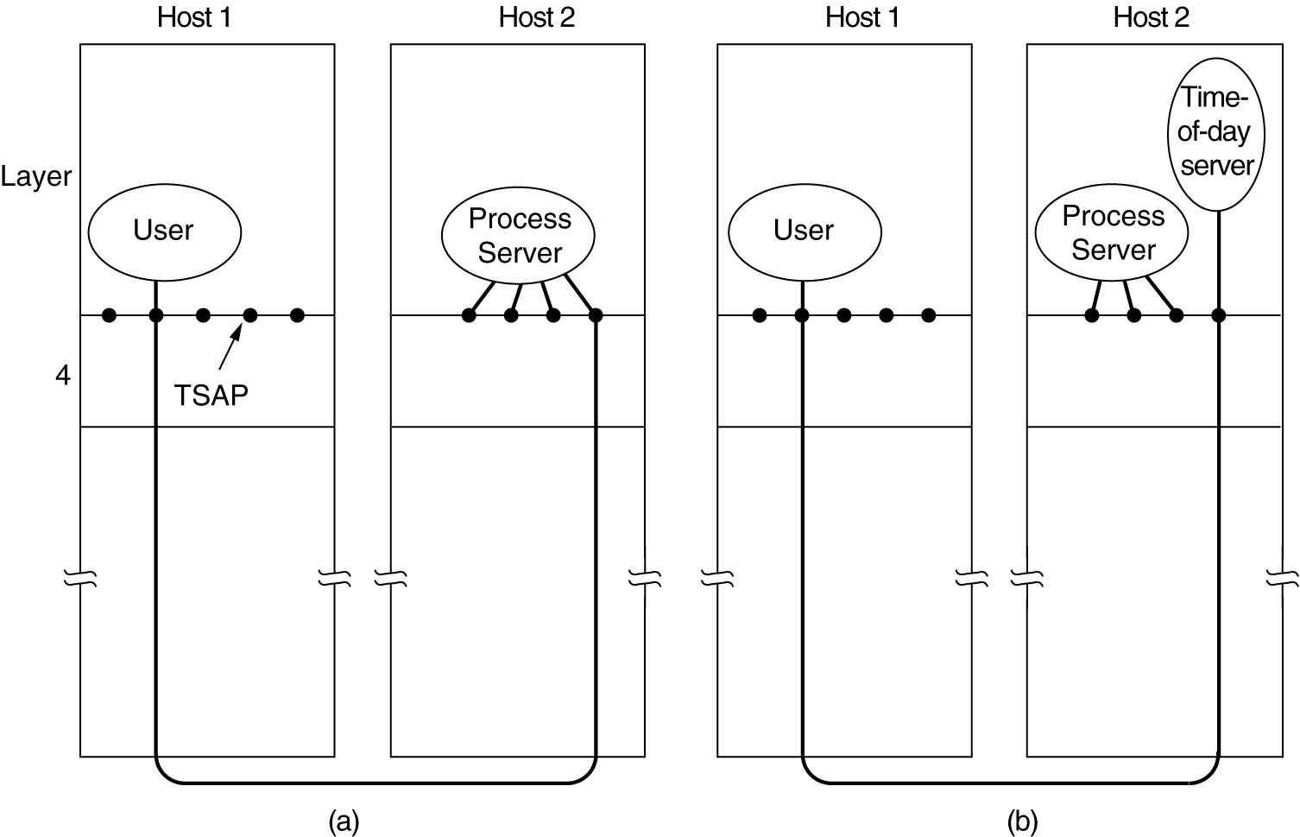
Connection Establishment
How a user process in host 1 establishes a connection with a time-of-day server in host 2.

Slide 14
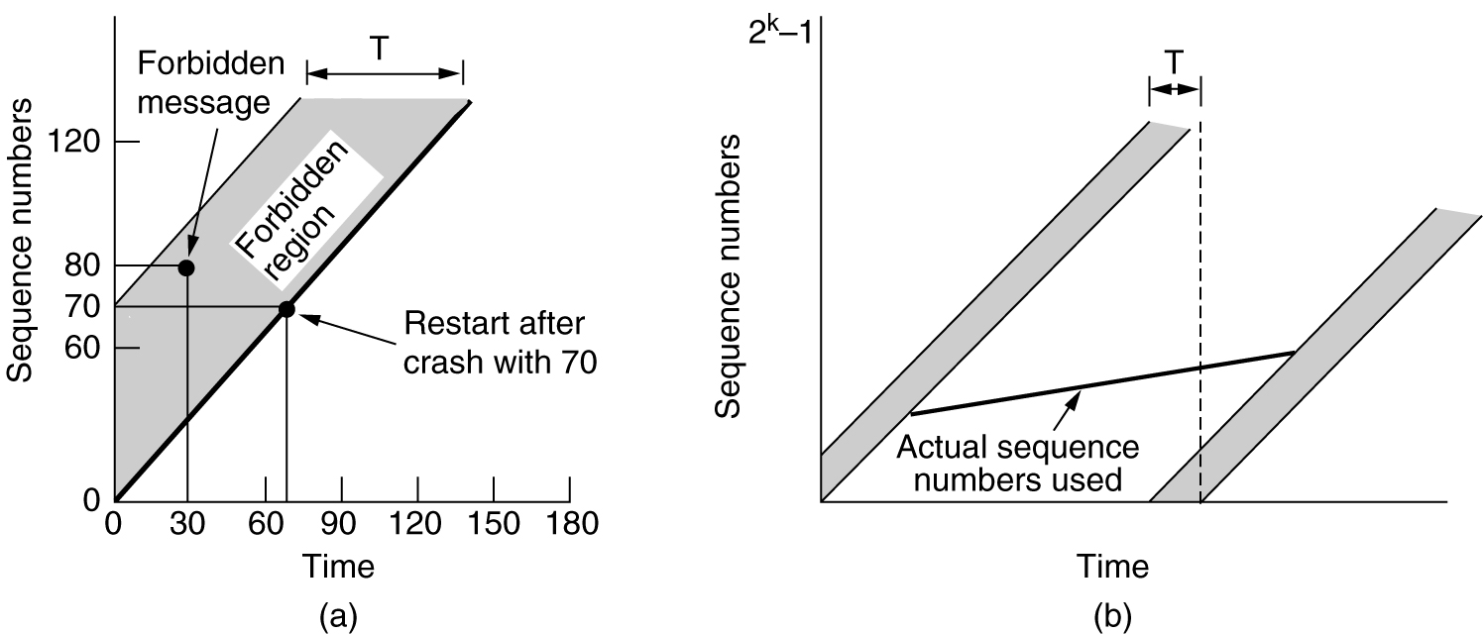
Connection Establishment (2)
(a) TPDUs may not enter the forbidden region.
(b) The resynchronization problem.

Slide 15
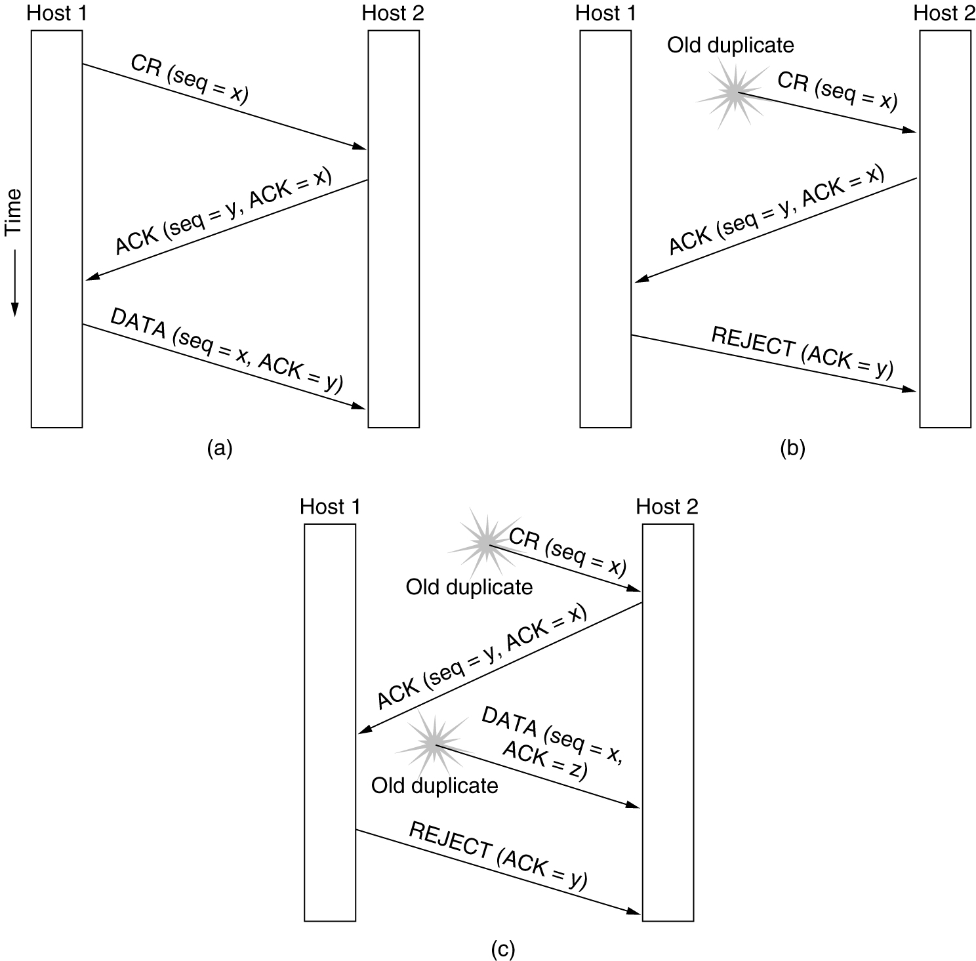
Connection Establishment (3)
Three protocol scenarios for establishing a connection using a three-way handshake. CR denotes CONNECTION REQUEST. (a) Normal operation, (b) Old CONNECTION REQUEST appearing out of nowhere. (c) Duplicate CONNECTION REQUEST and duplicate ACK.

Slide 16
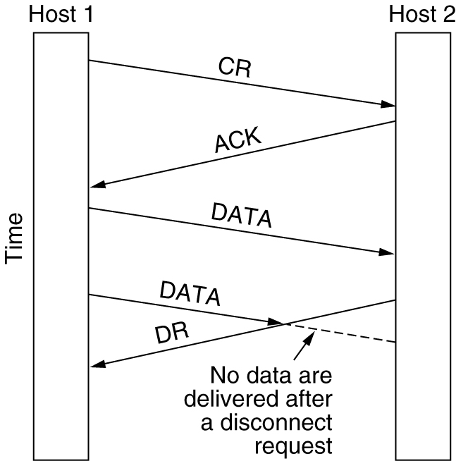
Connection Release
Abrupt disconnection with loss of data.

Slide 17
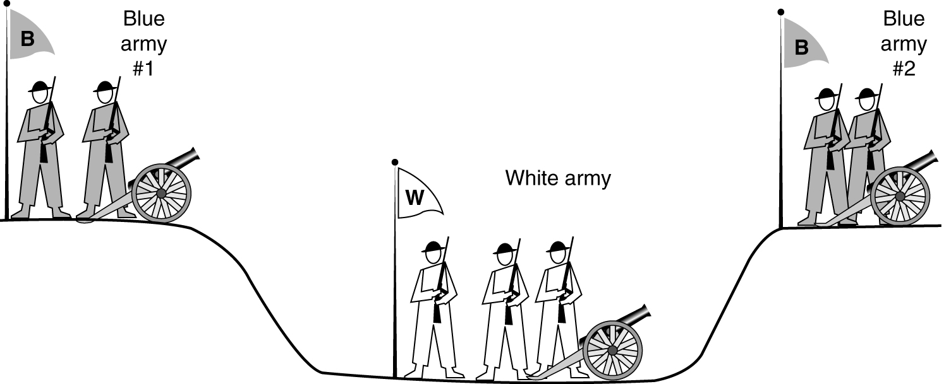
Connection Release (2)
The two-army problem.

Slide 18
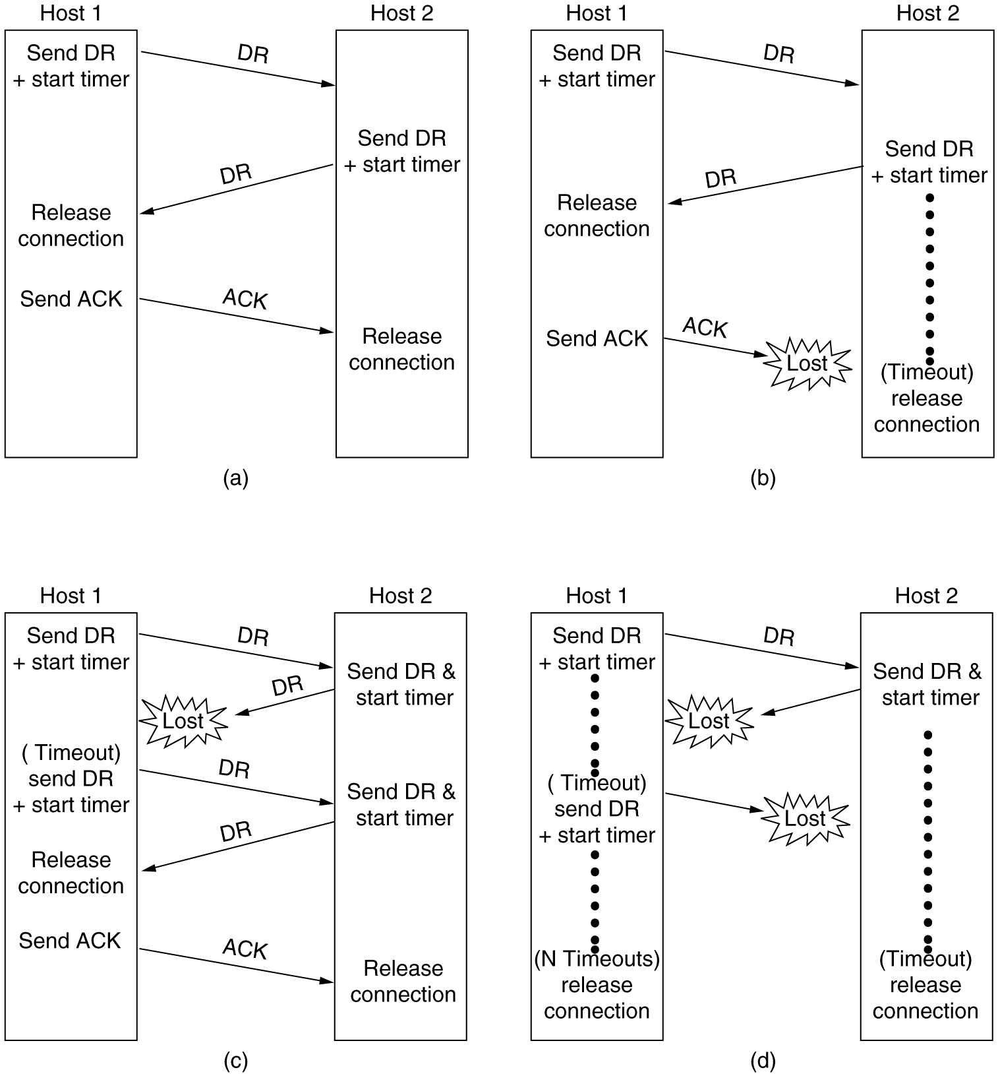
Connection Release (3)
6-14, a, b
Four protocol scenarios for releasing a connection. (a) Normal case of a three-way handshake. (b) final ACK lost.

Slide 19
Connection Release (4)
6-14, c,d
(c) Response lost. (d) Response lost and subsequent DRs lost.

Slide 20
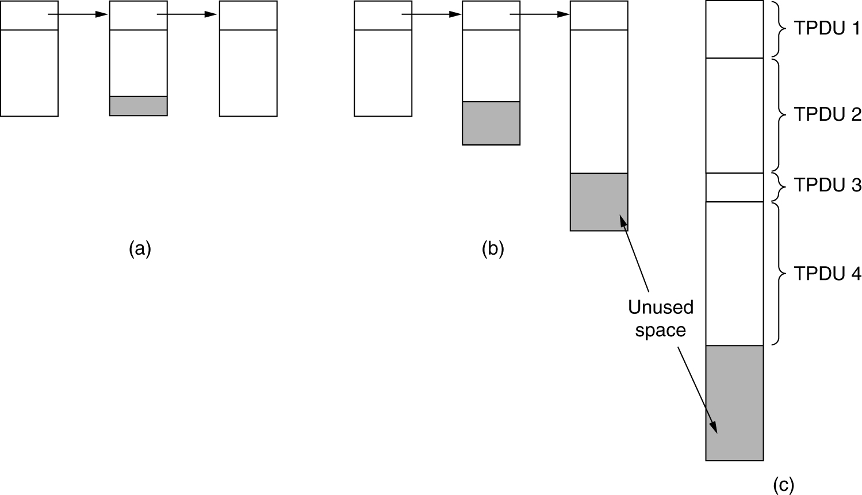
Flow Control and Buffering
(a) Chained fixed-size buffers. (b) Chained variable-sized buffers. (c) One large circular buffer per connection.

Slide 21
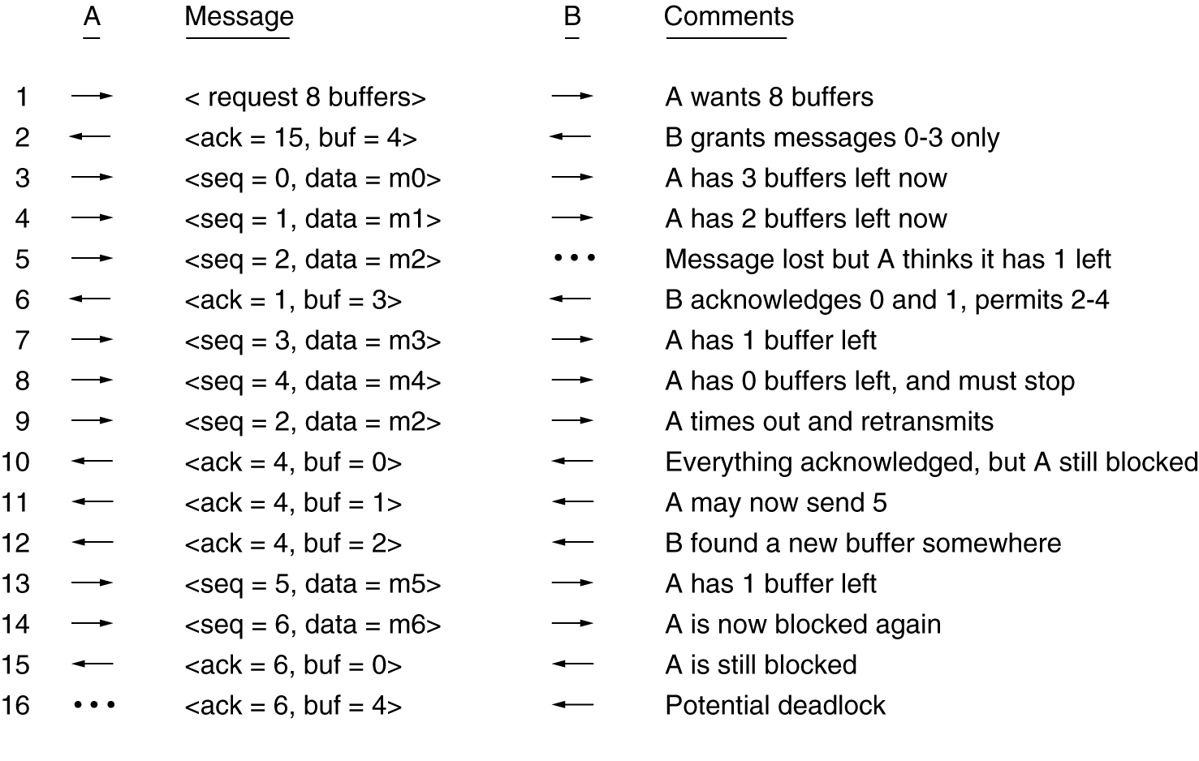
Flow Control and Buffering (2)
Dynamic buffer allocation. The arrows show the direction of transmission. An ellipsis (…) indicates a lost TPDU.

Slide 22
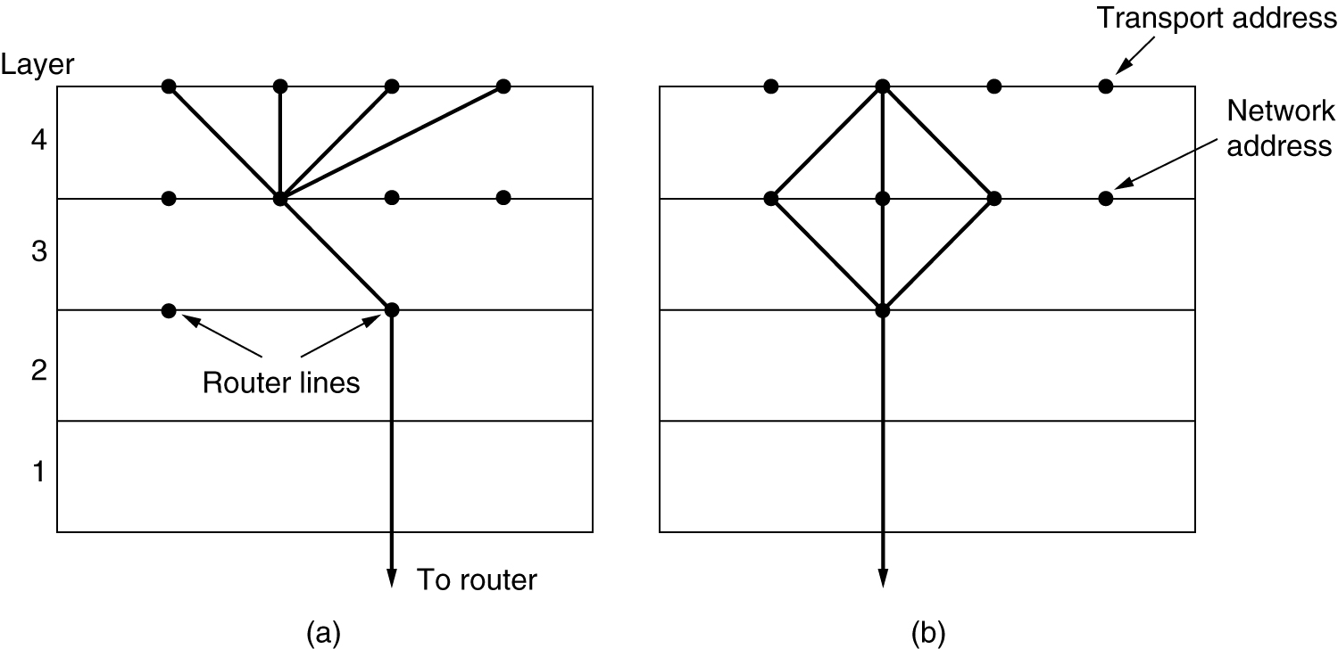
Multiplexing
(a) Upward multiplexing. (b) Downward multiplexing.

Slide 23
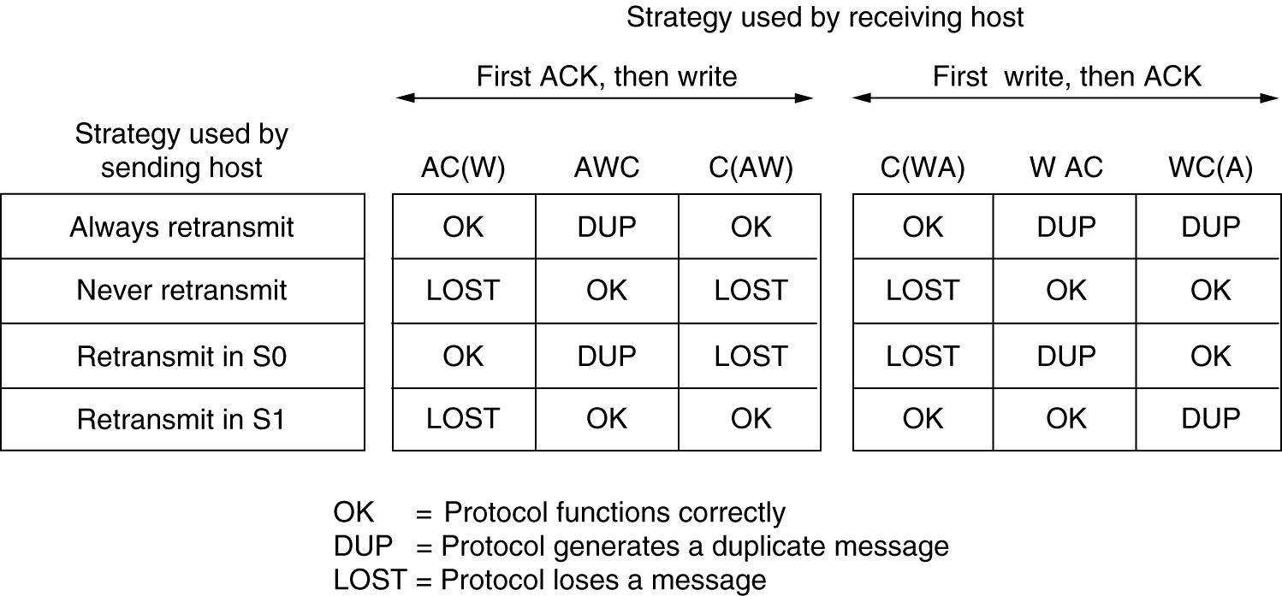
Crash Recovery
Different combinations of client and server strategy.

Slide 24
A Simple Transport Protocol
The Example Service Primitives
The Example Transport Entity
The Example as a Finite State Machine

Slide 25
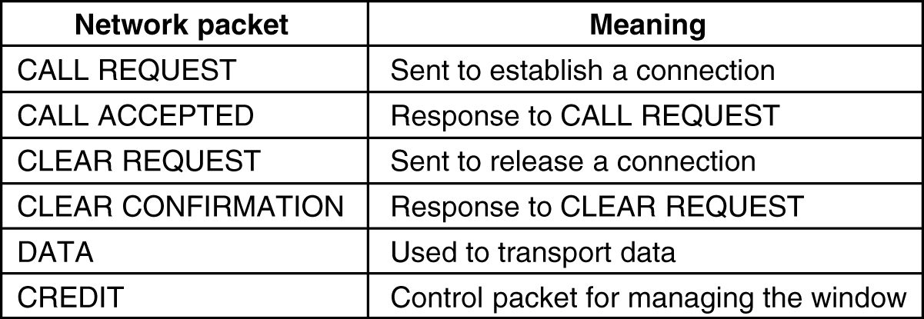
The Example Transport Entity
The network layer packets used in our example.

Slide 26
The Example Transport Entity (2)
Each connection is in one of seven states:
Idle – Connection not established yet.
Waiting – CONNECT has been executed, CALL REQUEST sent.
Queued – A CALL REQUEST has arrived; no LISTEN yet.
Established – The connection has been established.
Sending – The user is waiting for permission to send a packet.
Receiving – A RECEIVE has been done.
DISCONNECTING – a DISCONNECT has been done locally.

Slide 27
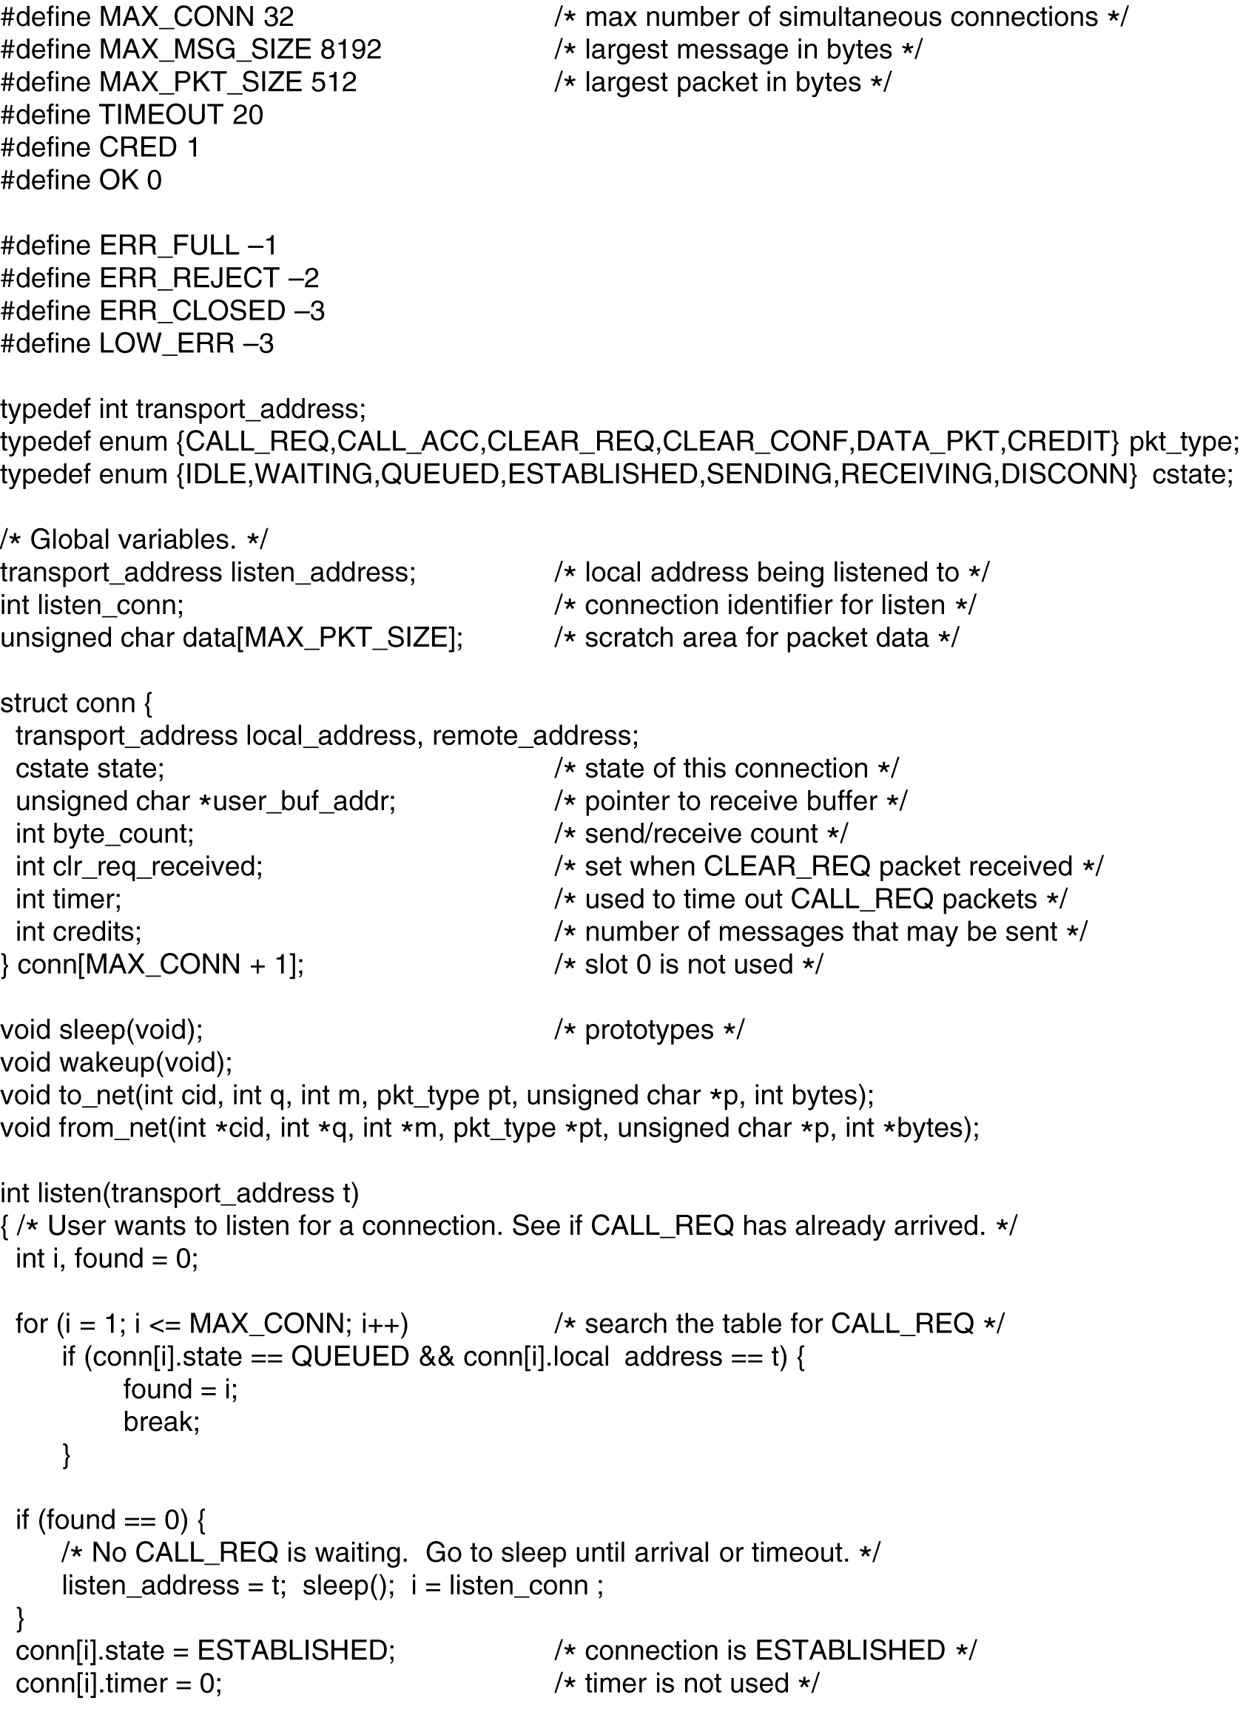
The Example Transport Entity (3)

Slide 28
The Example Transport Entity (4)

Slide 29
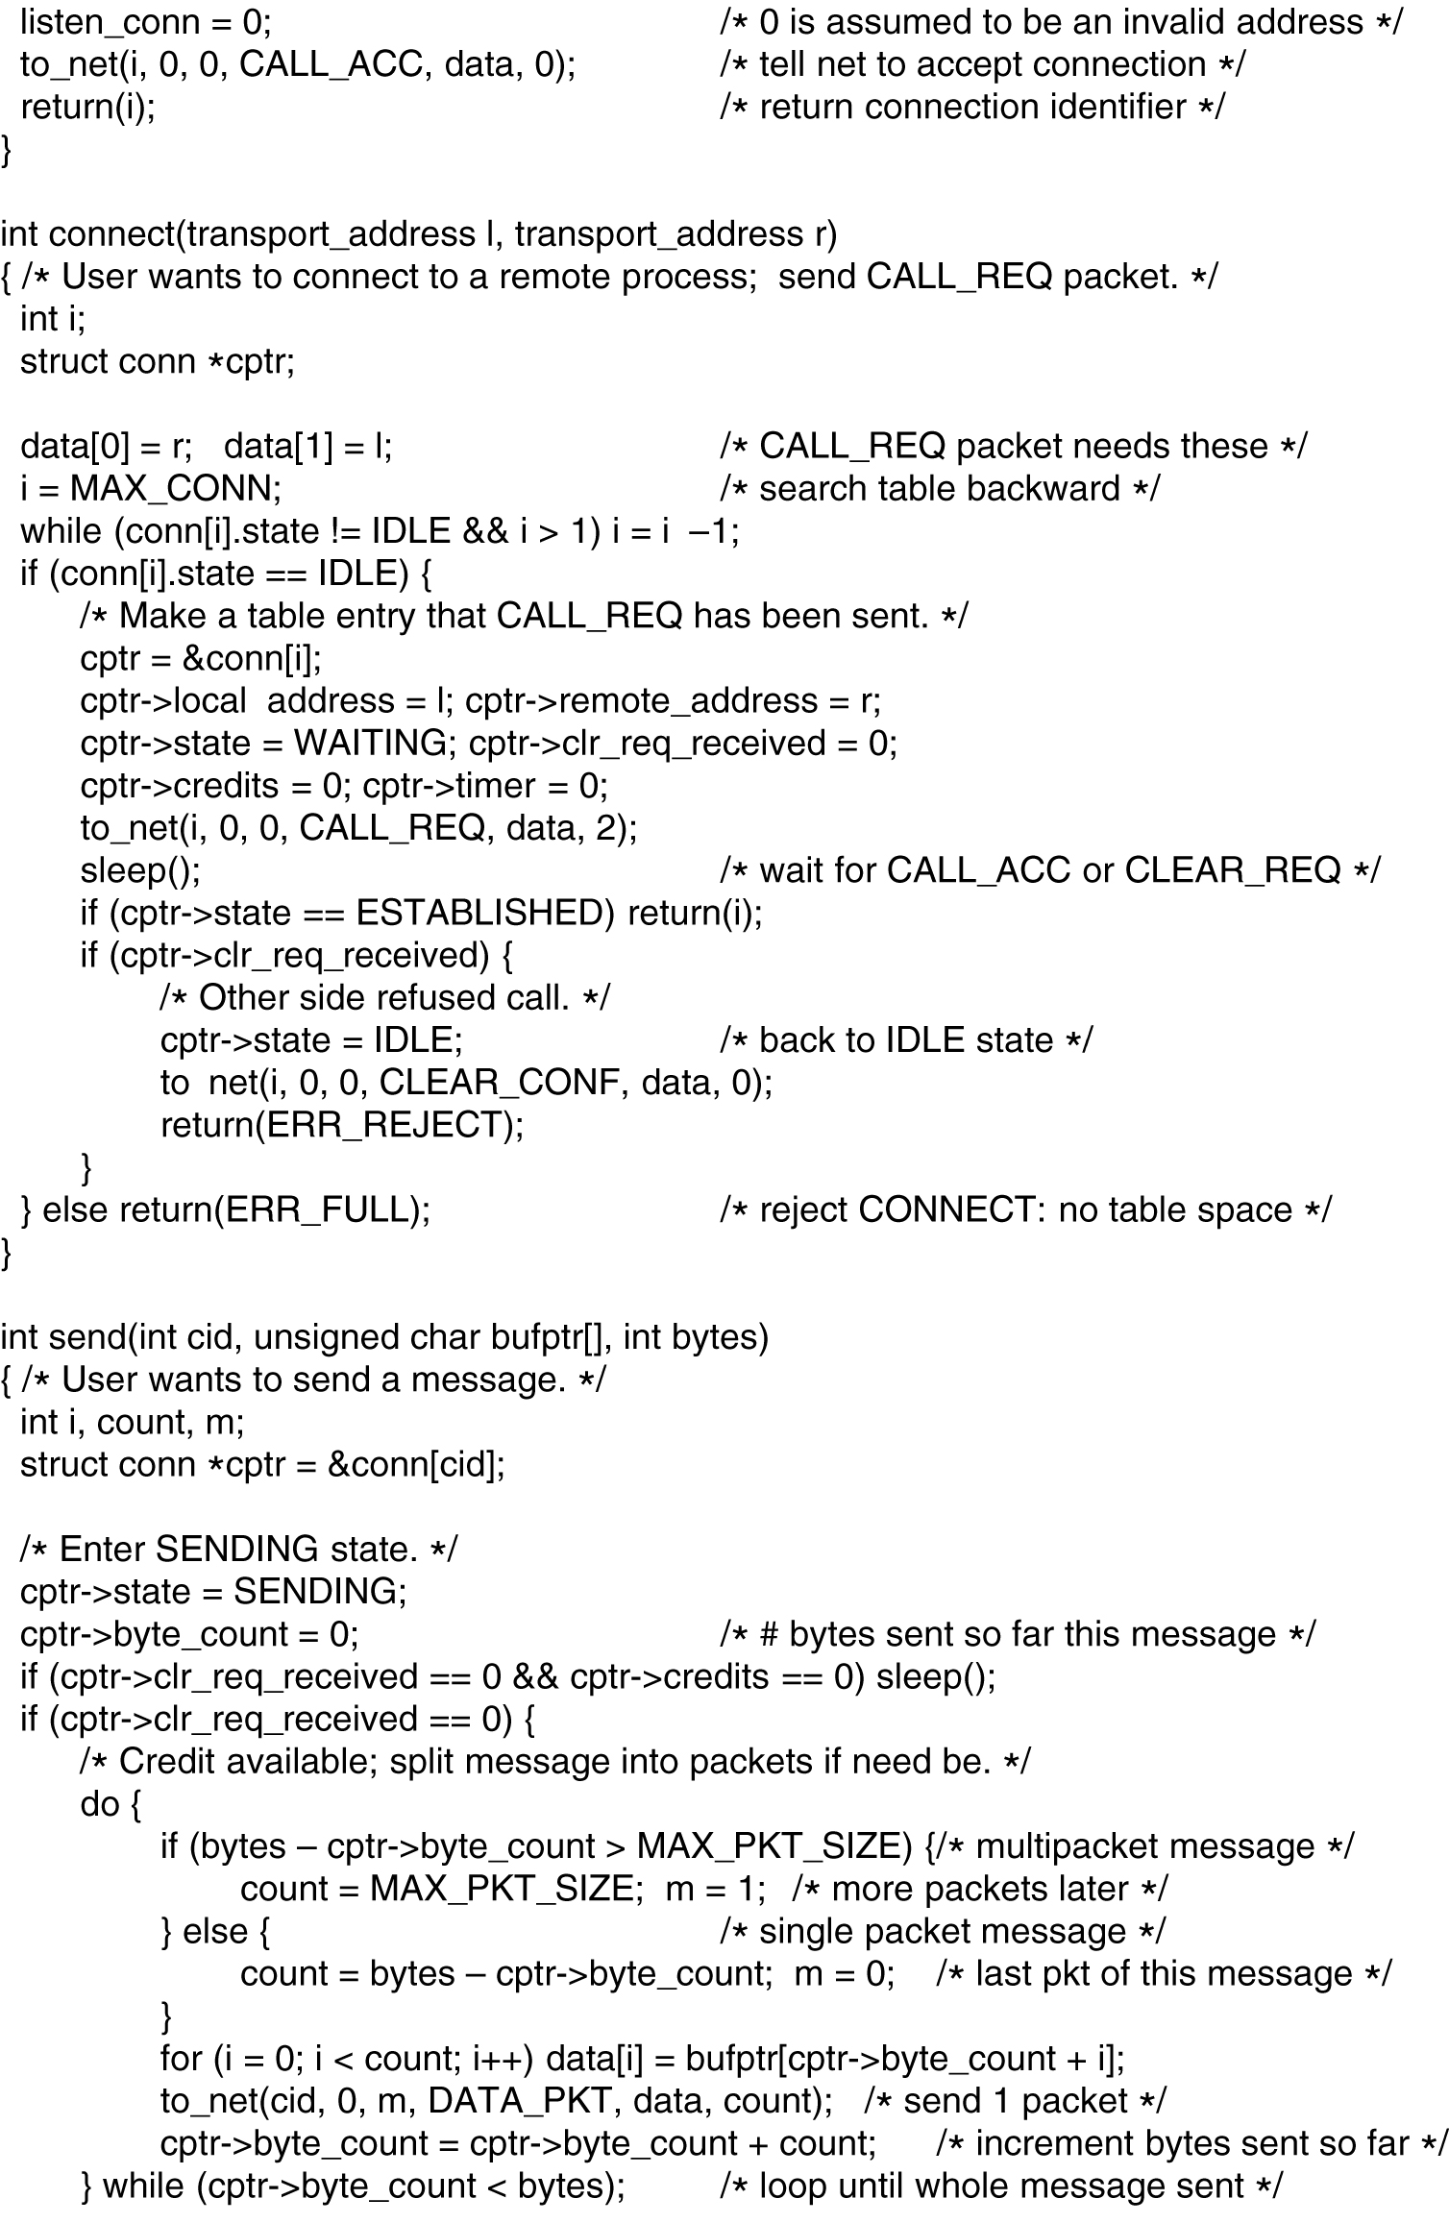
The Example Transport Entity (5)

Slide 30
The Example Transport Entity (6)

Slide 31
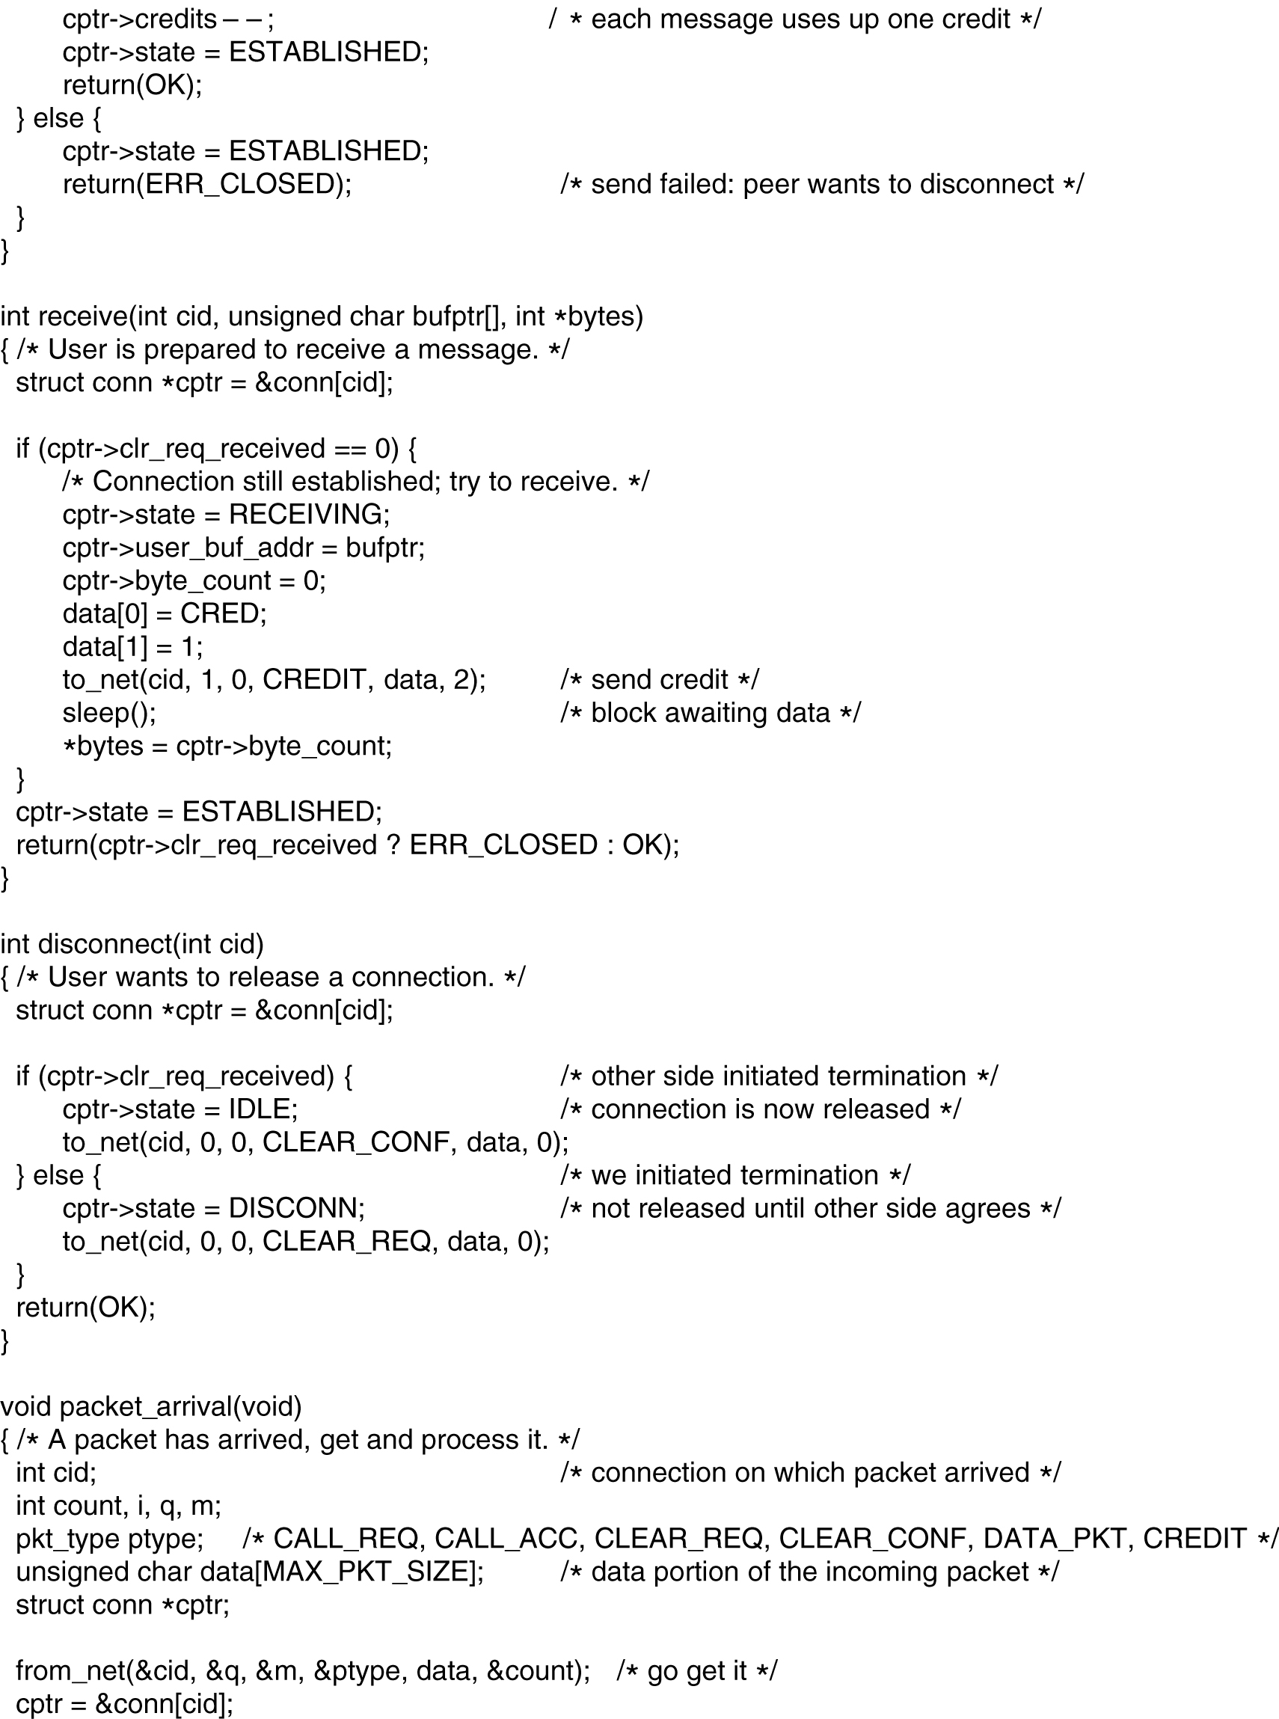
The Example Transport Entity (7)

Slide 32
The Example Transport Entity (8)

Slide 33
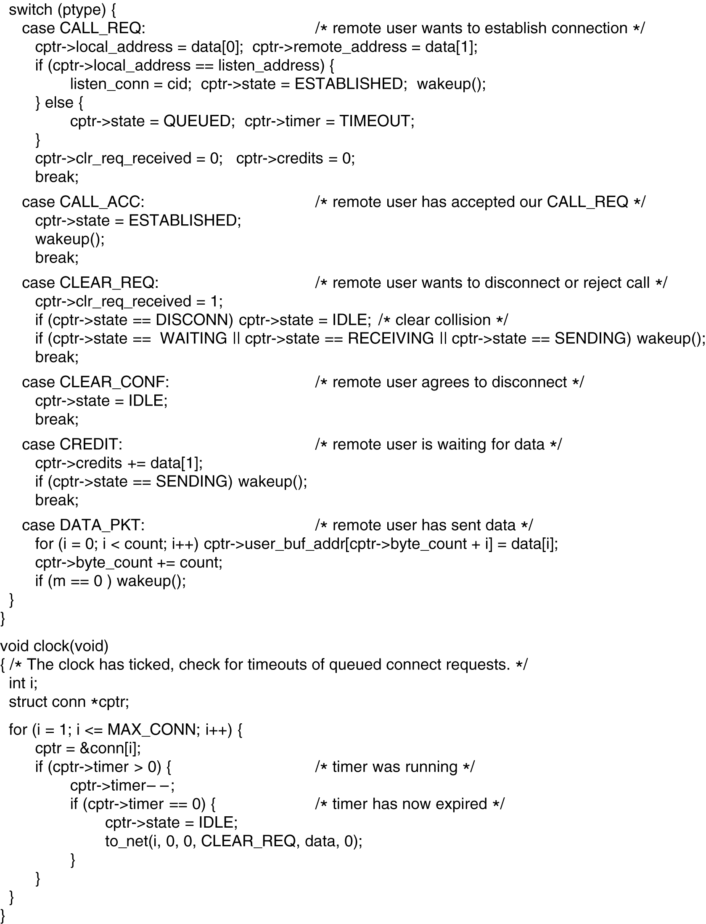
The Example Transport Entity (9)

Slide 34
The Example Transport Entity (10)

Slide 35
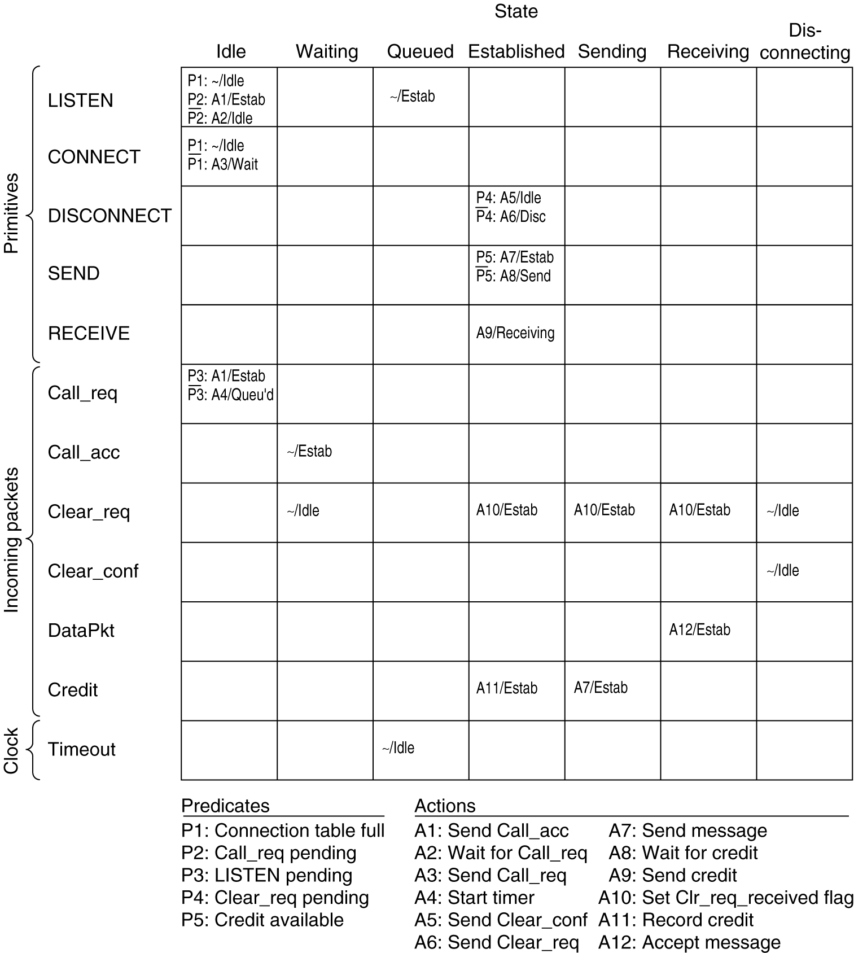
The Example as a Finite State Machine
The example protocol as a finite state machine. Each entry has an optional predicate, an optional action, and the new state. The tilde indicates that no major action is taken. An overbar above a predicate indicate the negation of the predicate. Blank entries correspond to impossible or invalid events.

Slide 36
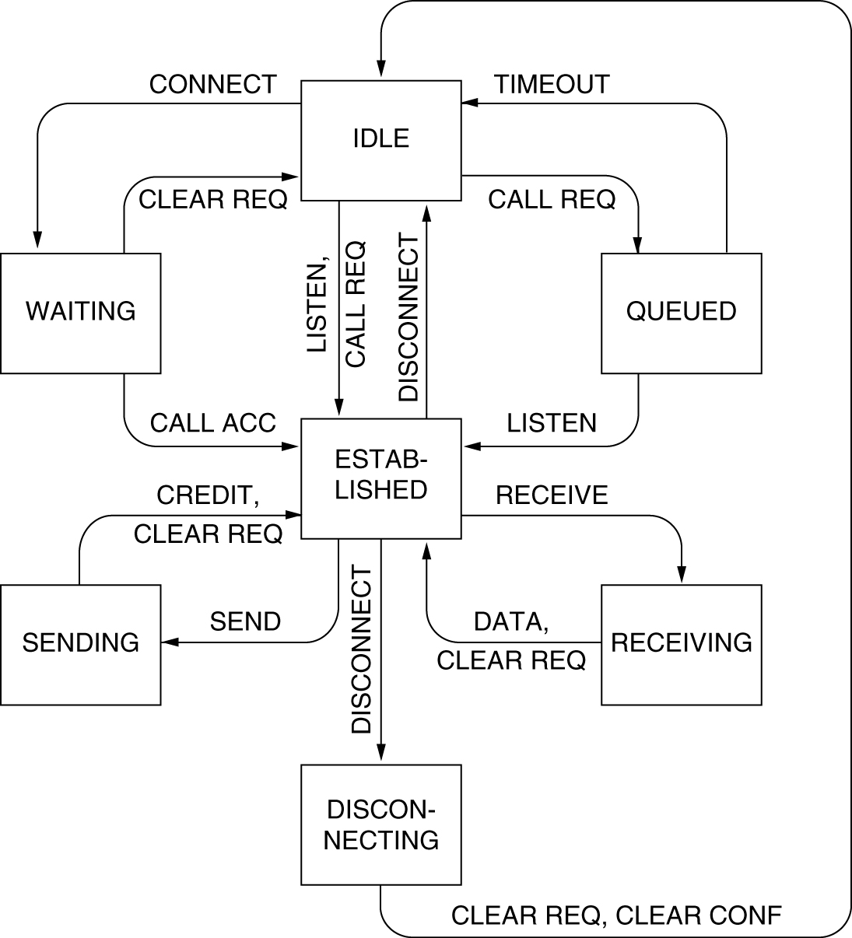
The Example as a Finite State Machine (2)
The example protocol in graphical form. Transitions that leave the connection state unchanged have been omitted for simplicity.

Slide 37
The Internet Transport Protocols: UDP
Introduction to UDP
Remote Procedure Call
The Real-Time Transport Protocol

Slide 38
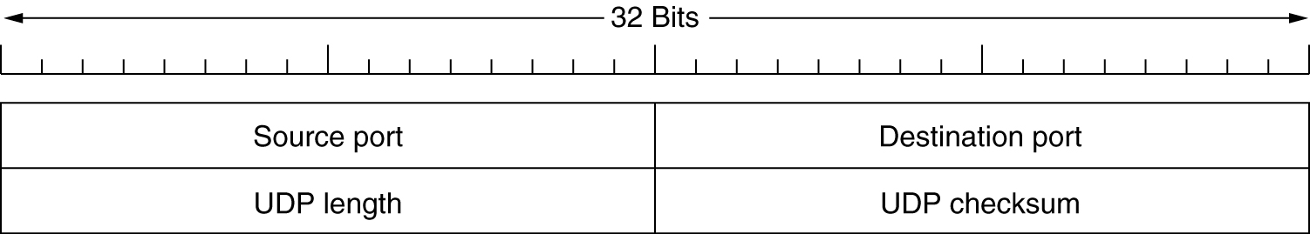
Introduction to UDP
The UDP header.

Slide 39
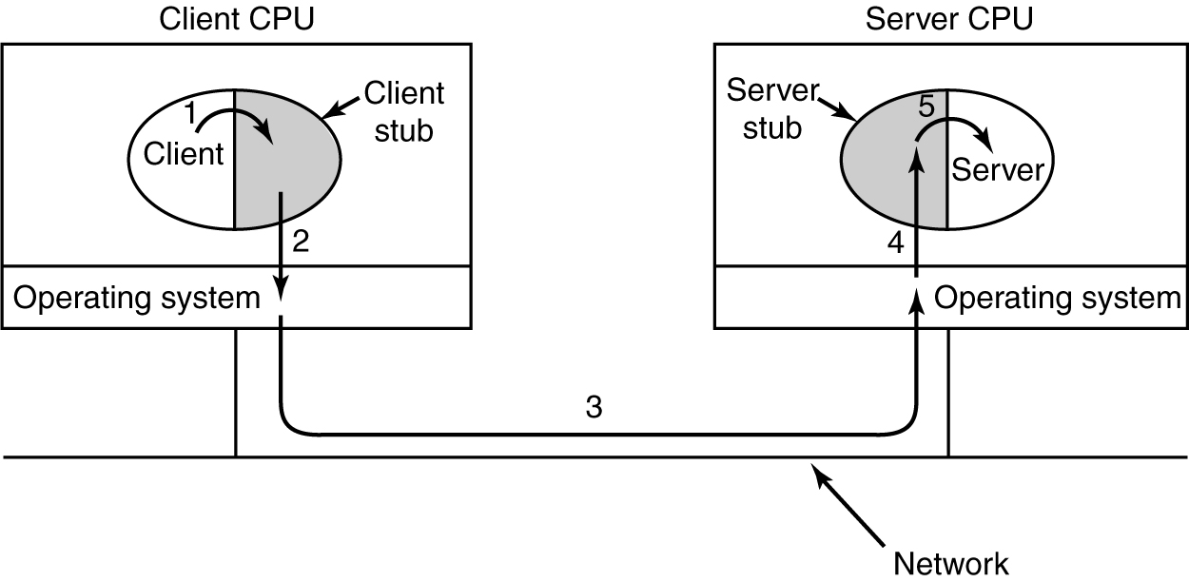
Remote Procedure Call
Steps in making a remote procedure call. The stubs are shaded.

Slide 40
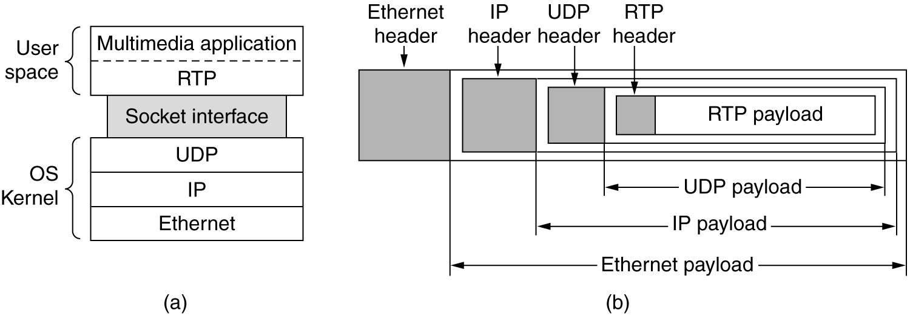
The Real-Time Transport Protocol
(a) The position of RTP in the protocol stack. (b) Packet nesting.

Slide 41
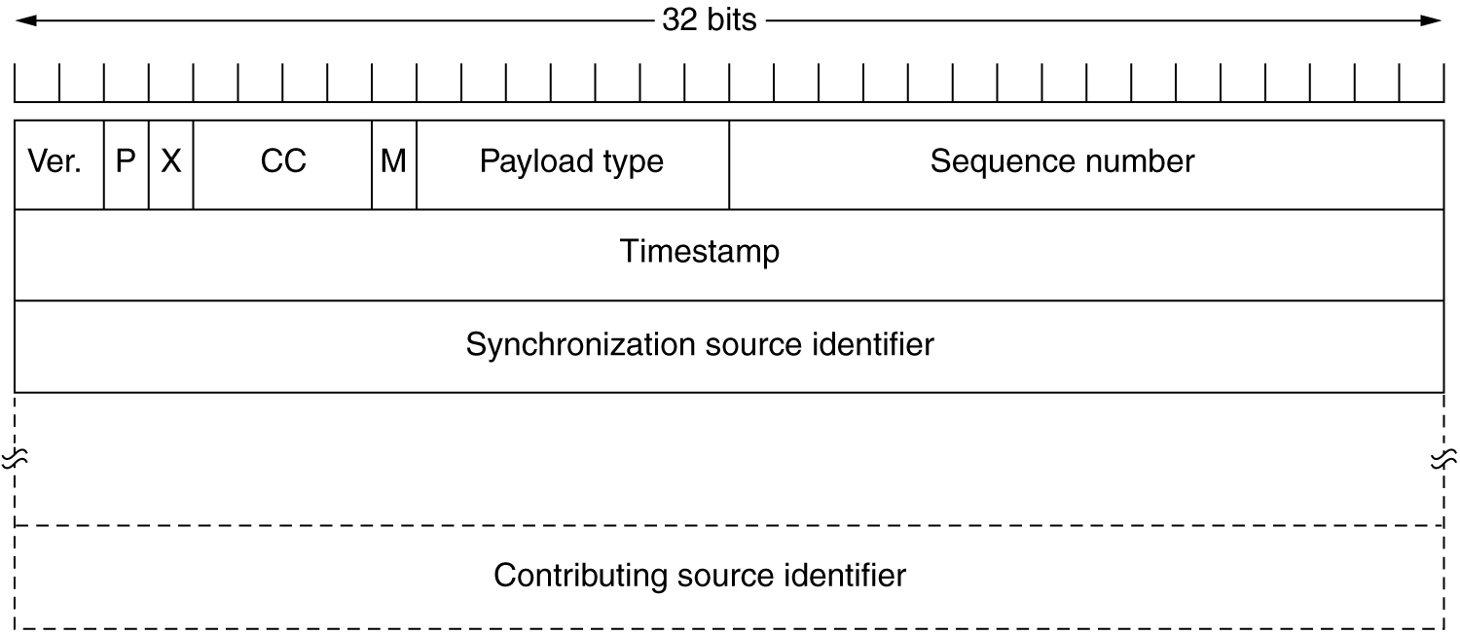
The Real-Time Transport Protocol (2)
The RTP header.

Slide 42
The Internet Transport Protocols: TCP
Introduction to TCP
The TCP Service Model
The TCP Protocol
The TCP Segment Header
TCP Connection Establishment
TCP Connection Release
TCP Connection Management Modeling
TCP Transmission Policy
TCP Congestion Control
TCP Timer Management
Wireless TCP and UDP
Transactional TCP

Slide 43
The TCP Service Model
Port
Protocol
Use
21
FTP
File transfer
23
Telnet
Remote login
25
SMTP
E-mail
69
TFTP
Trivial File Transfer Protocol
79
Finger
Lookup info about a user
80
HTTP
World Wide Web
110
POP-3
Remote e-mail access
119
NNTP
USENET news
Some assigned ports.

Slide 44
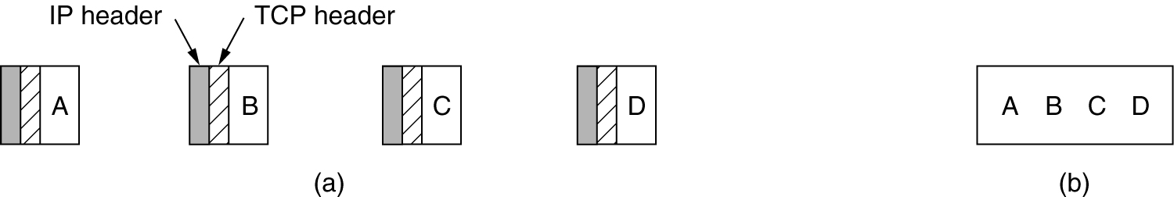
The TCP Service Model (2)
(a) Four 512-byte segments sent as separate IP datagrams.
(b) The 2048 bytes of data delivered to the application in a single READ CALL.

Slide 45
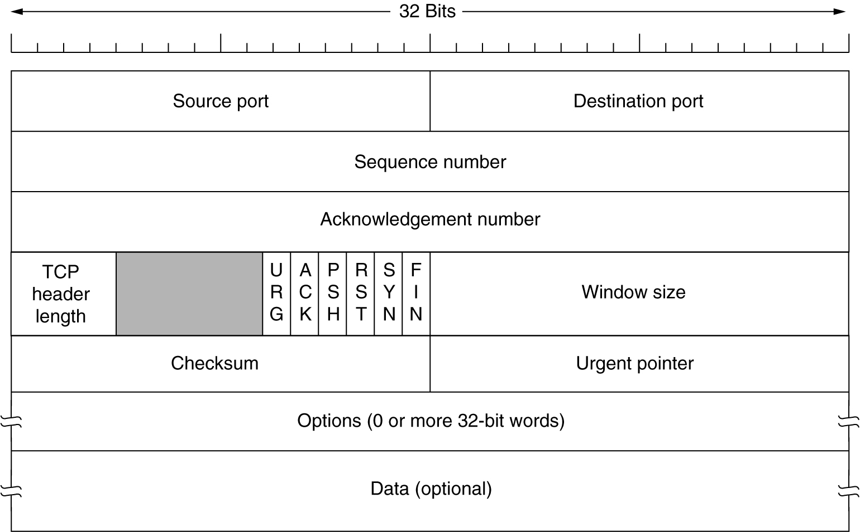
The TCP Segment Header
TCP Header.

Slide 46
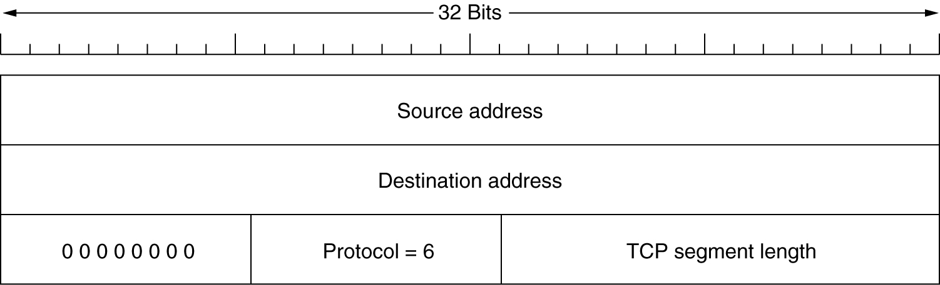
The TCP Segment Header (2)
The pseudoheader included in the TCP checksum.

Slide 47
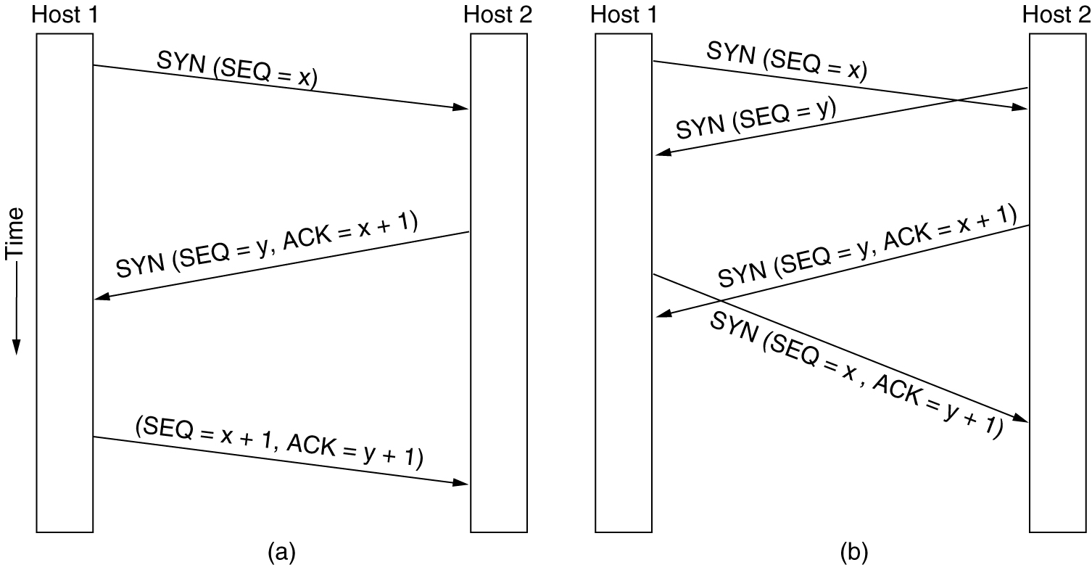
TCP Connection Establishment
6-31
(a) TCP connection establishment in the normal case.
(b) Call collision.

Slide 48
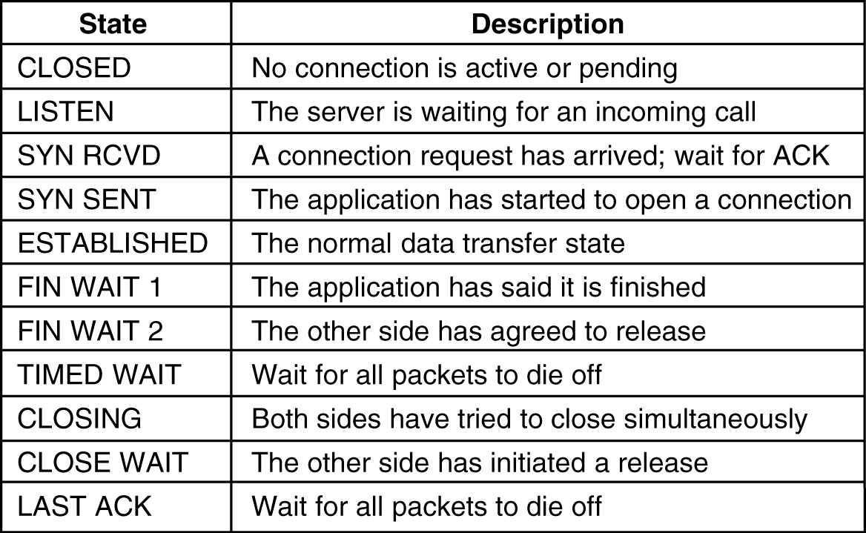
TCP Connection Management Modeling
The states used in the TCP connection management finite state machine.

Slide 49
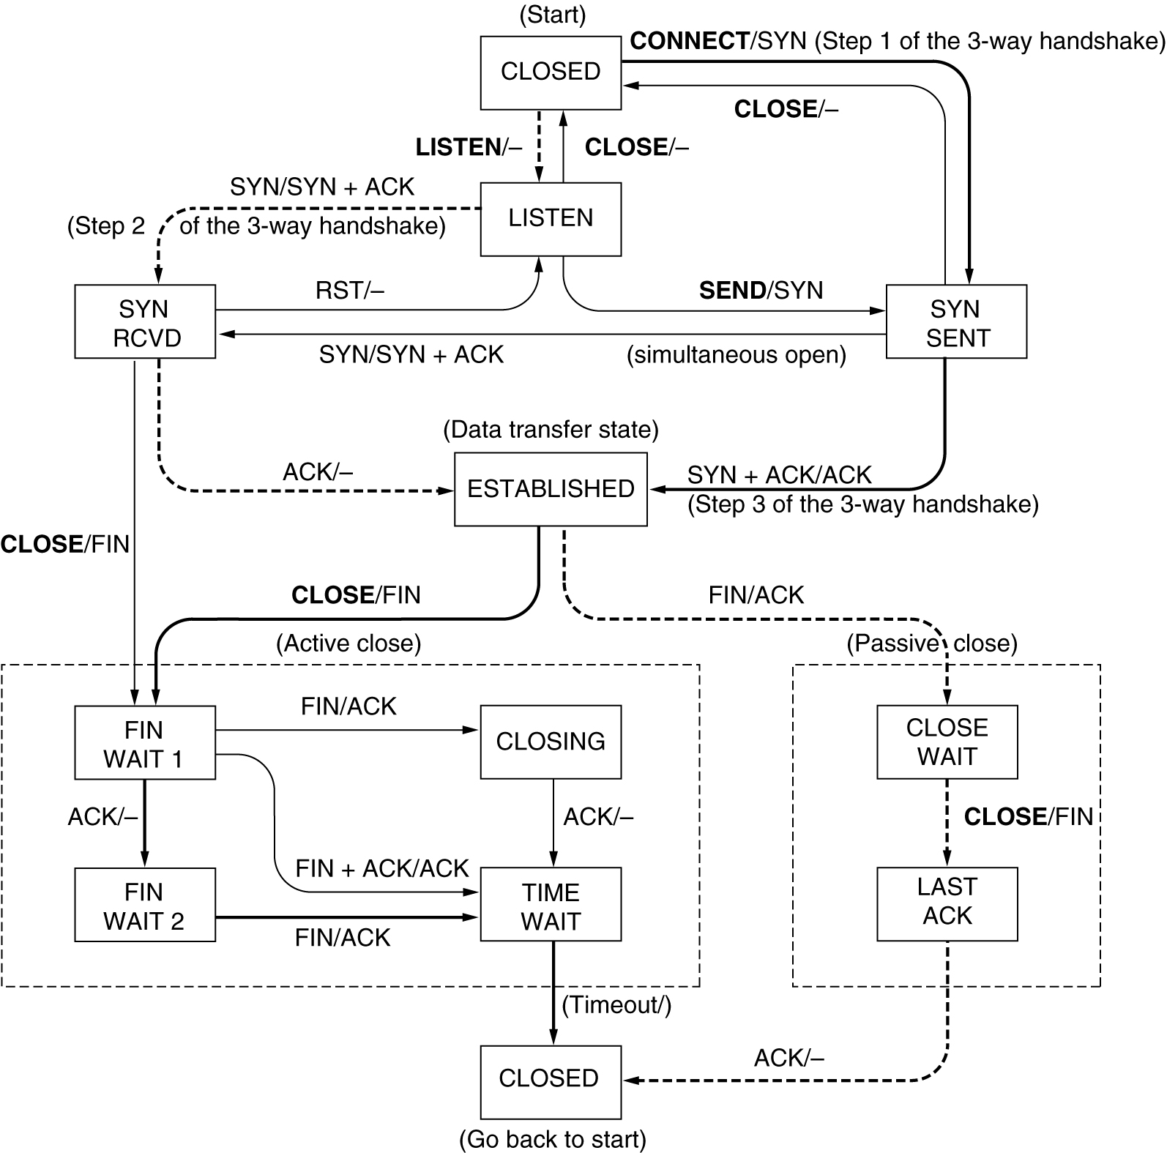
TCP Connection Management Modeling (2)
TCP connection management finite state machine. The heavy solid line is the normal path for a client. The heavy dashed line is the normal path for a server. The light lines are unusual events. Each transition is labeled by the event causing it and the action resulting from it, separated by a slash.

Slide 50
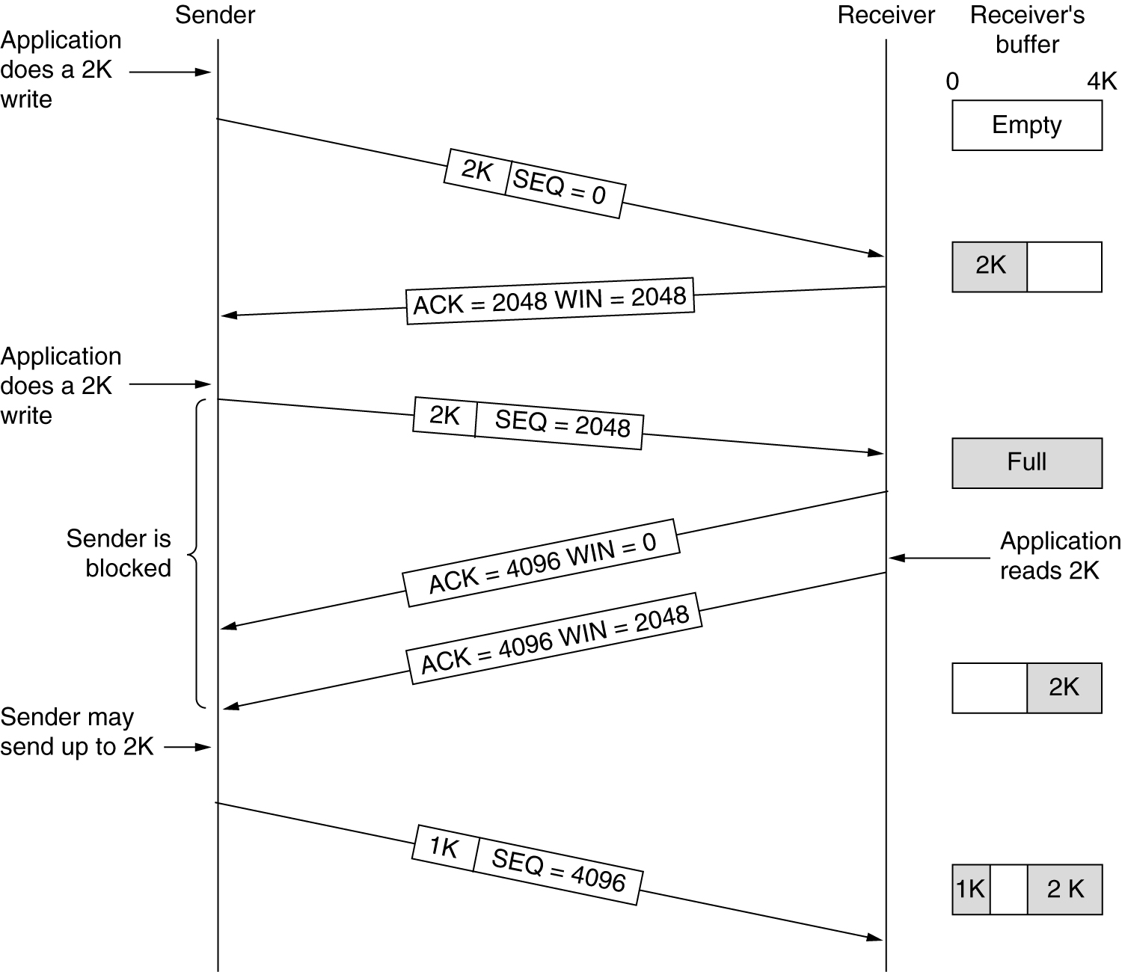
TCP Transmission Policy
Window management in TCP.

Slide 51
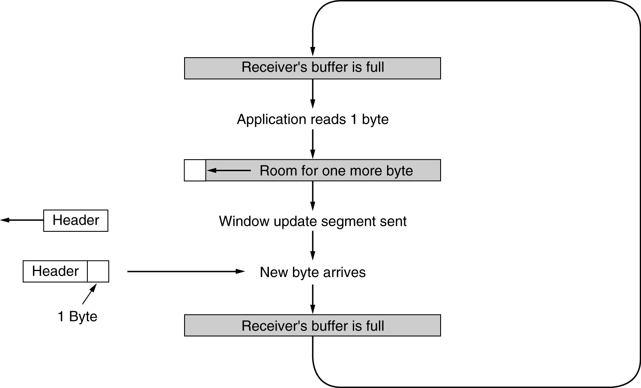
TCP Transmission Policy (2)
Silly window syndrome.

Slide 52
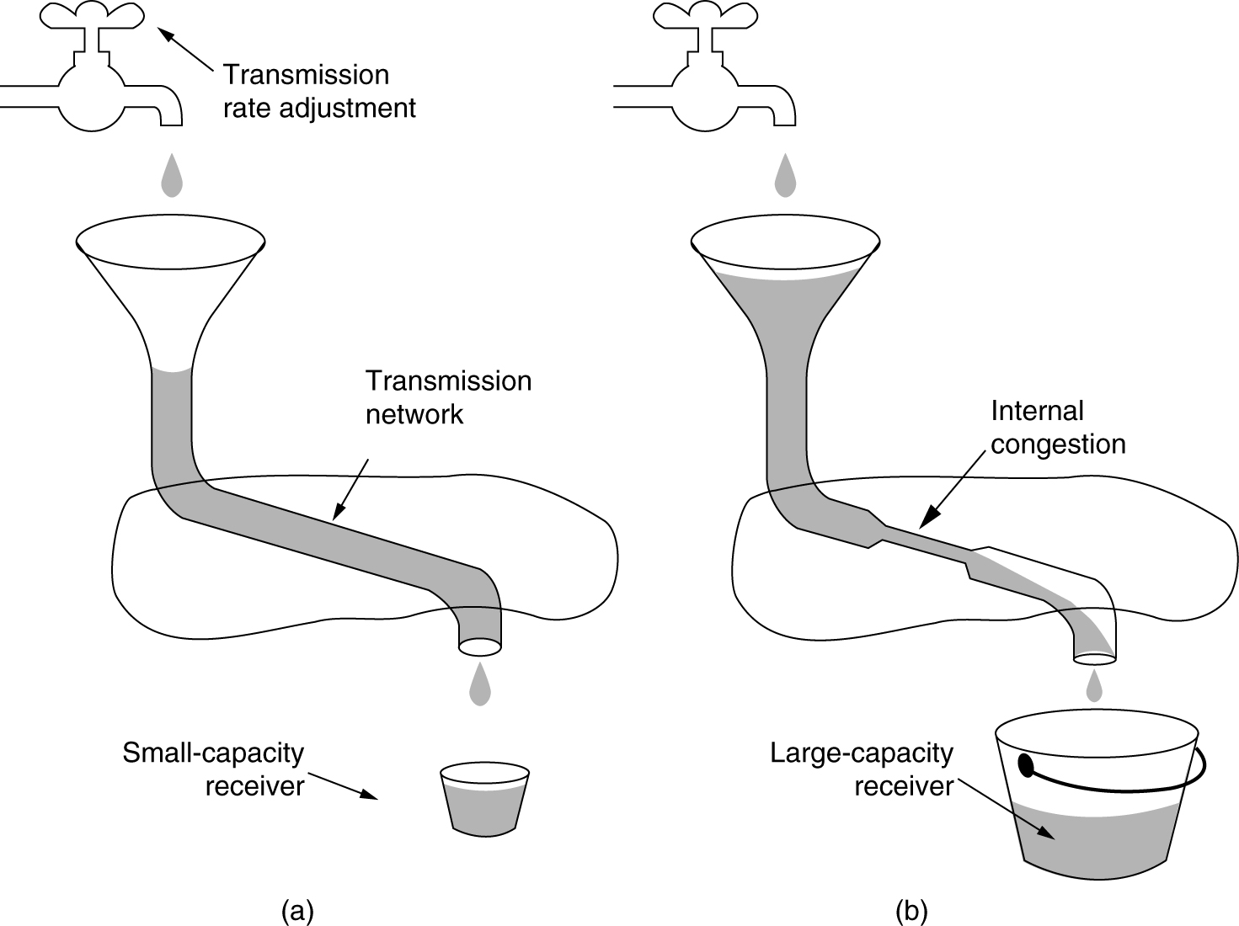
TCP Congestion Control
(a) A fast network feeding a low capacity receiver.
(b) A slow network feeding a high-capacity receiver.

Slide 53
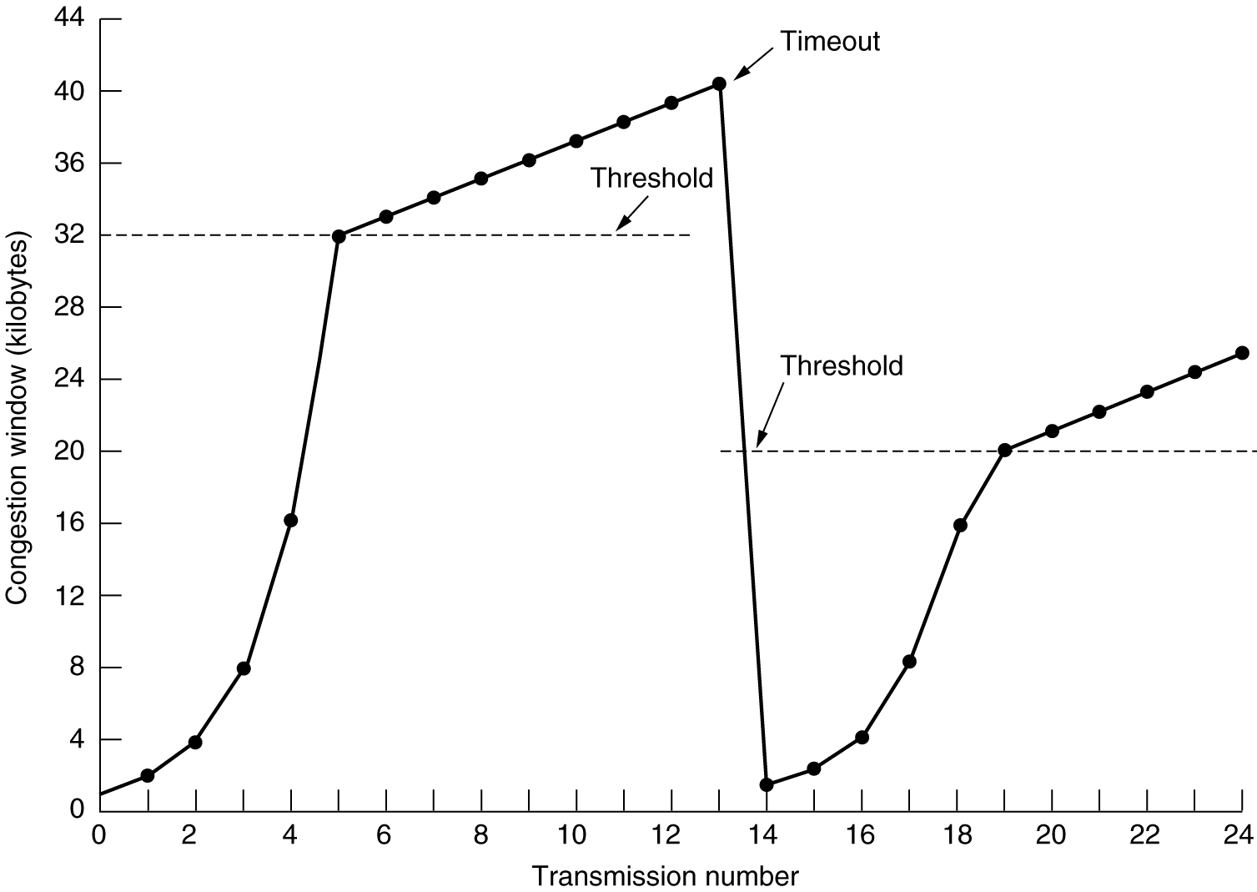
TCP Congestion Control (2)
An example of the Internet congestion algorithm.

Slide 54
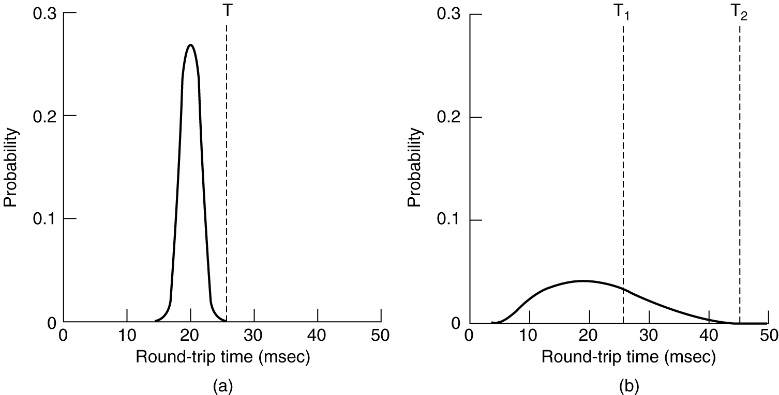
TCP Timer Management
(a) Probability density of ACK arrival times in the data link layer.
(b) Probability density of ACK arrival times for TCP.

Slide 55
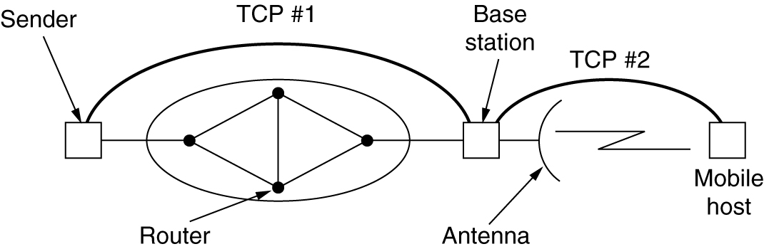
Wireless TCP and UDP
Splitting a TCP connection into two connections.

Slide 56
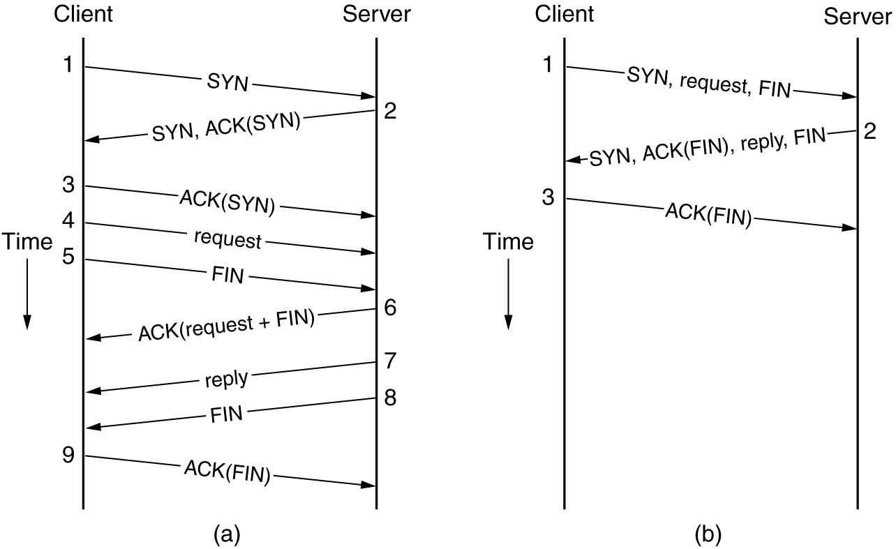
Transitional TCP
(a) RPC using normal TPC.
(b) RPC using T/TCP.

Slide 57
Performance Issues
Performance Problems in Computer Networks
Network Performance Measurement
System Design for Better Performance
Fast TPDU Processing
Protocols for Gigabit Networks

Slide 58
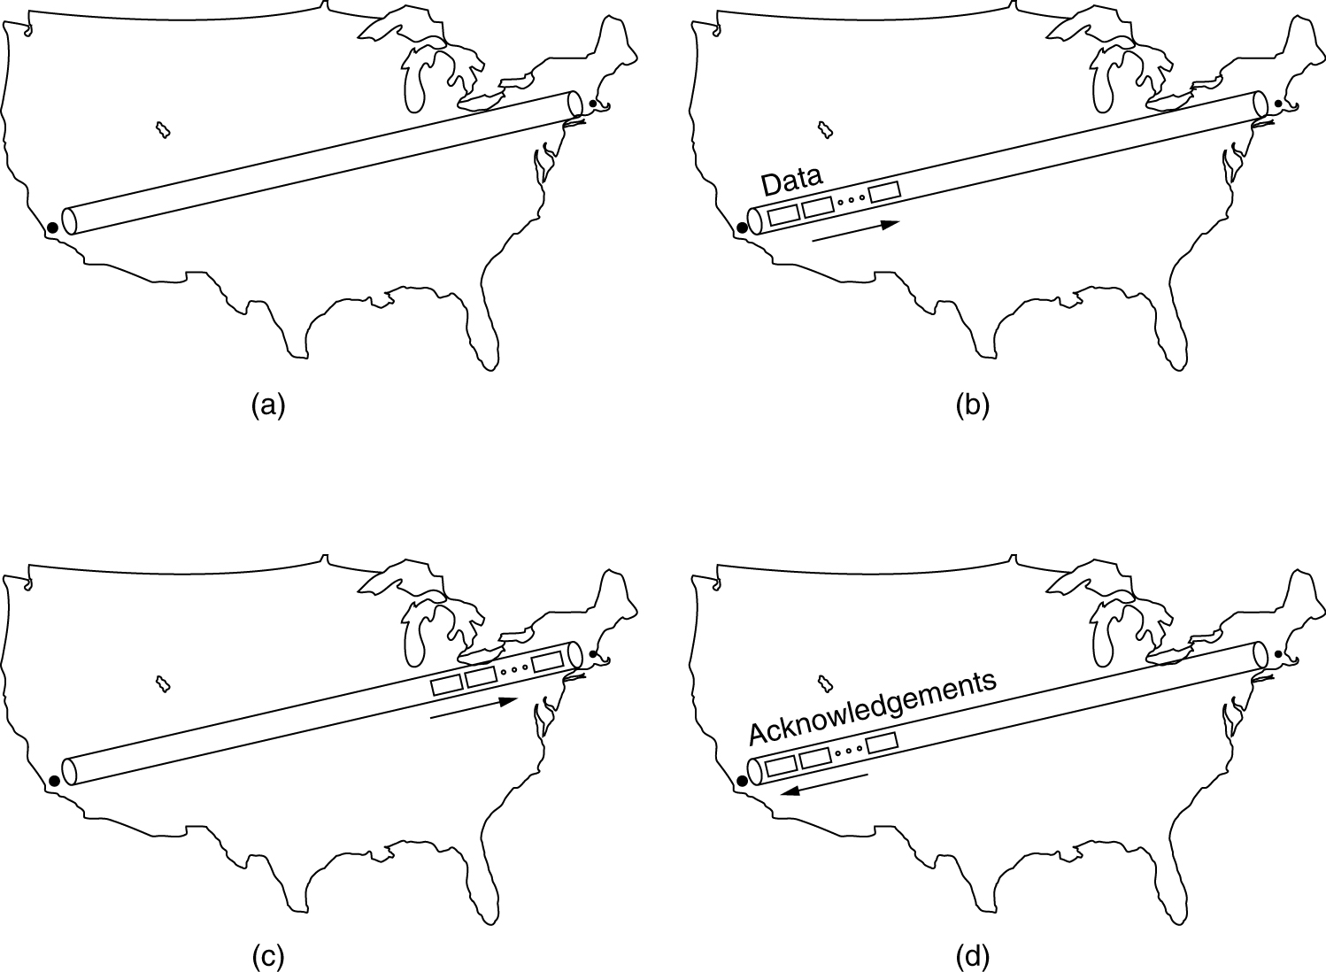
Performance Problems in Computer Networks
The state of transmitting one megabit from San Diego to Boston
(a) At t = 0, (b) After 500 μsec, (c) After 20 msec, (d) after 40 msec.

Slide 59
Network Performance Measurement
The basic loop for improving network performance.
Measure relevant network parameters, performance.
Try to understand what is going on.
Change one parameter.

Slide 60
System Design for Better Performance
Rules:
CPU speed is more important than network speed.
Reduce packet count to reduce software overhead.
Minimize context switches.
Minimize copying.
You can buy more bandwidth but not lower delay.
Avoiding congestion is better than recovering from it.
Avoid timeouts.

Slide 61
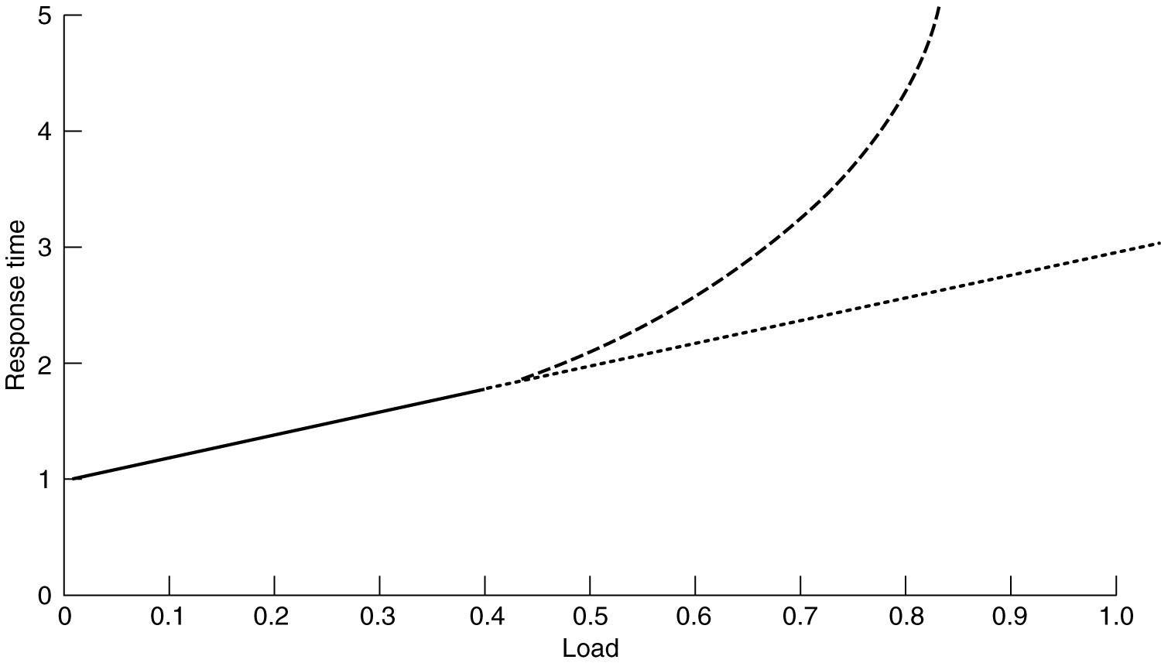
System Design for Better Performance (2)
Response as a function of load.

Slide 62
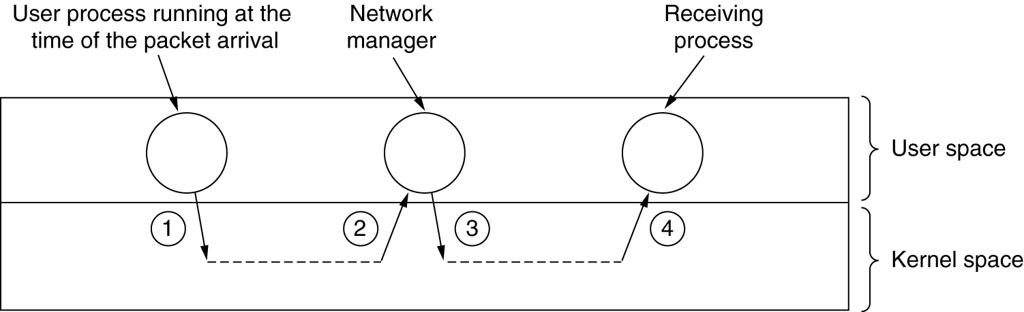
System Design for Better Performance (3)
Four context switches to handle one packet
with a user-space network manager.

Slide 63
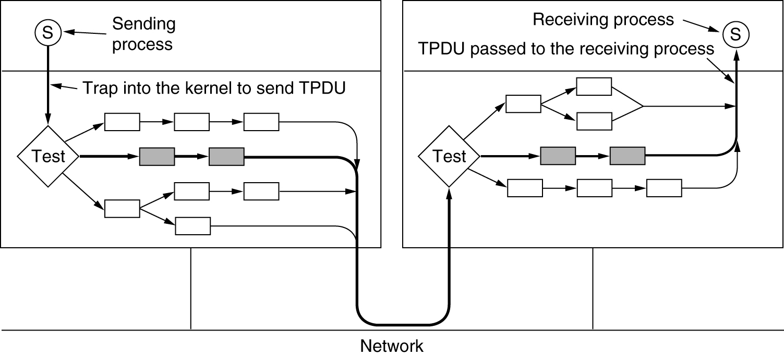
Fast TPDU Processing
The fast path from sender to receiver is shown with a heavy line.
The processing steps on this path are shaded.

Slide 64
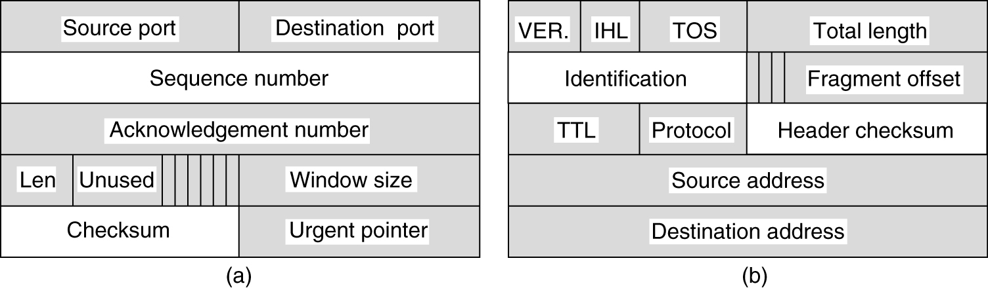
Fast TPDU Processing (2)
(a) TCP header. (b) IP header. In both cases, the shaded fields are taken from the prototype without change.

Slide 65
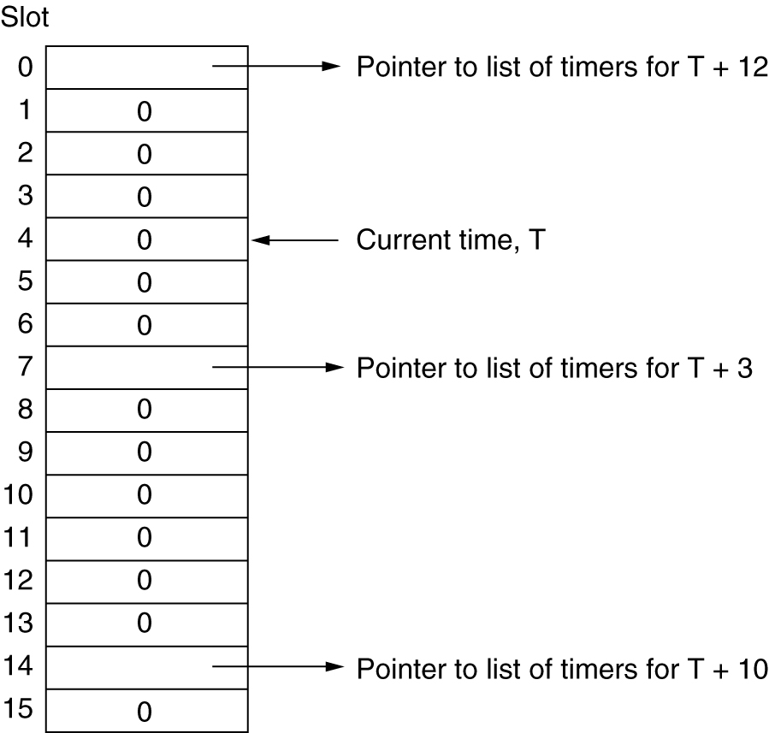
Fast TPDU Processing (3)
A timing wheel.

Slide 66
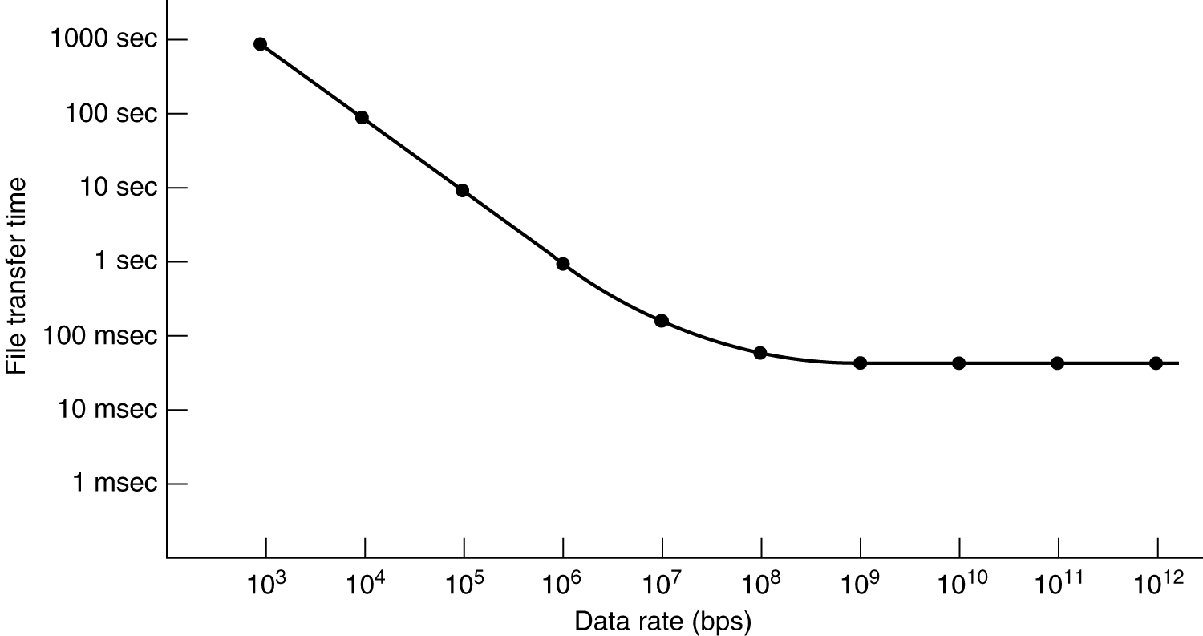
Protocols for Gigabit Networks
Time to transfer and acknowledge a 1-megabit file over a 4000-km line.

